Slide 1
The Jovian Planets

Slide 2
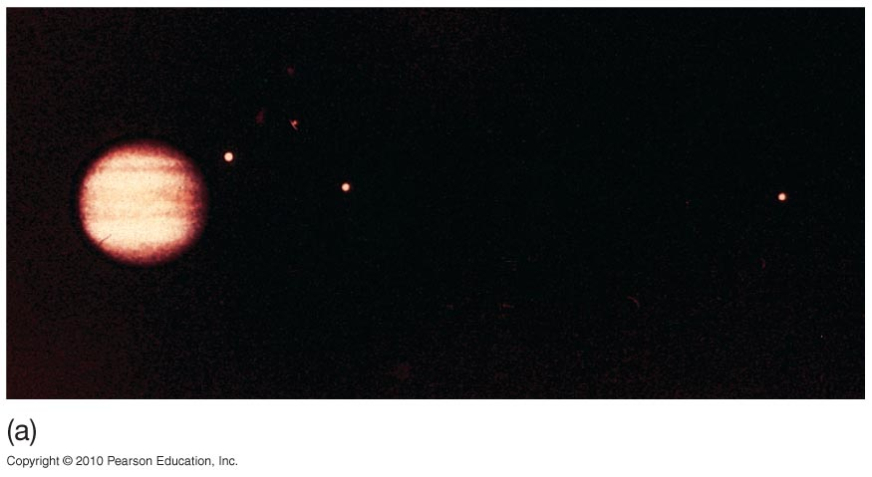
Observations of Jupiter and Saturn
Jupiter can be imaged well from Earth, even with a small telescope.
Here: Jupiter with its Galilean moons

Slide 3
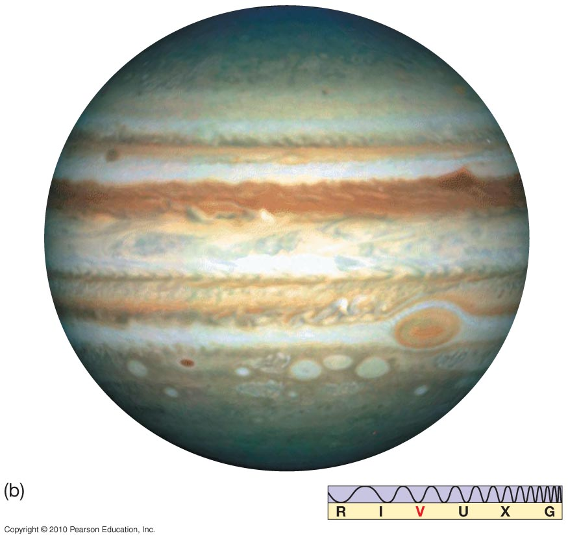
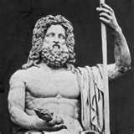
Observations of Jupiter
Natural color image
Jupiter: King of Gods

Slide 4
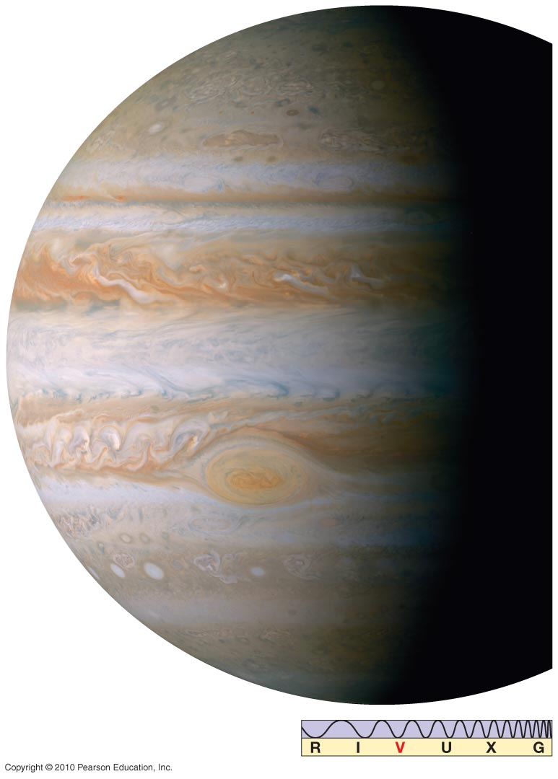
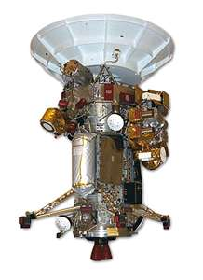
Observations of Jupiter and Saturn
Cassini image of Jupiter, true color $3.3 Billion 1977 to 2017

Slide 5
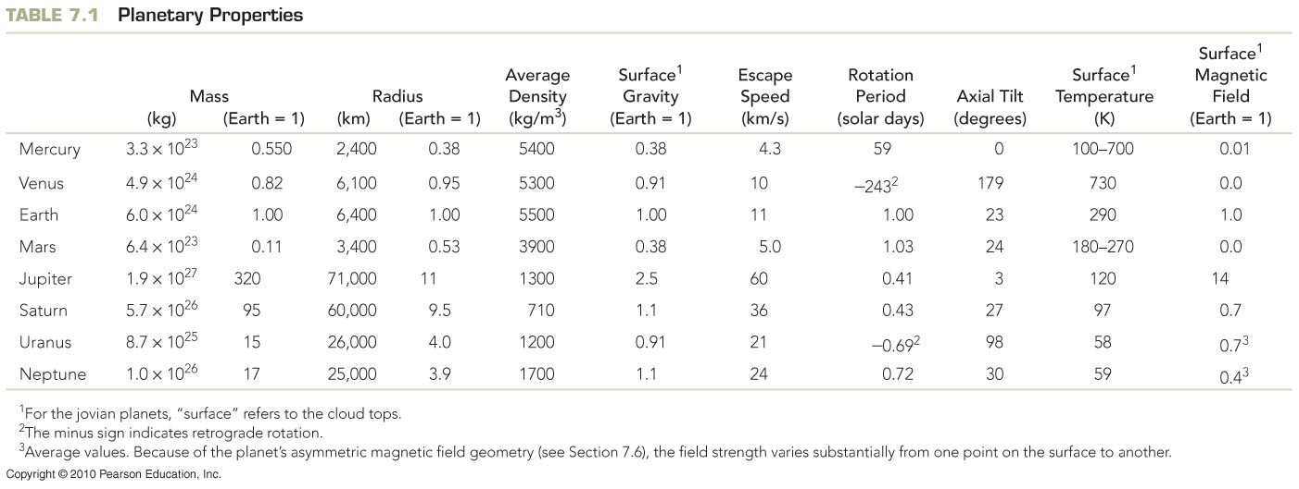
Bulk Properties of the Jovian Planets
The Jovian planets are large and much less dense than the terrestrial planets; Saturn is less dense than water!

Slide 6
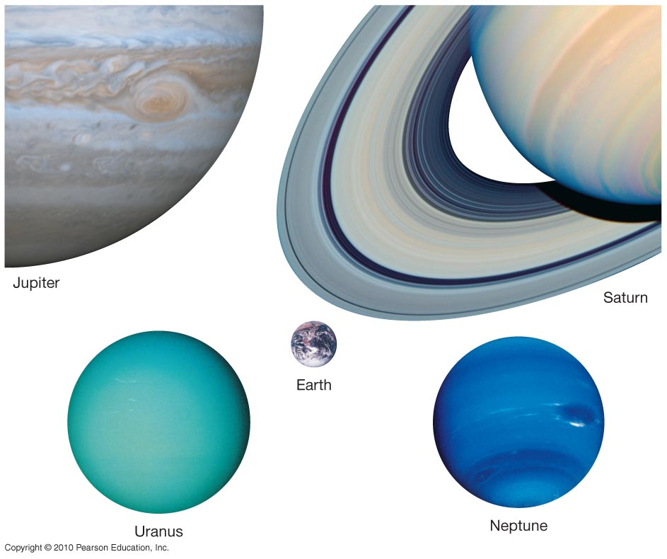
Bulk Properties of the Jovian Planets
Jovian planets, compared to Earth

Slide 7
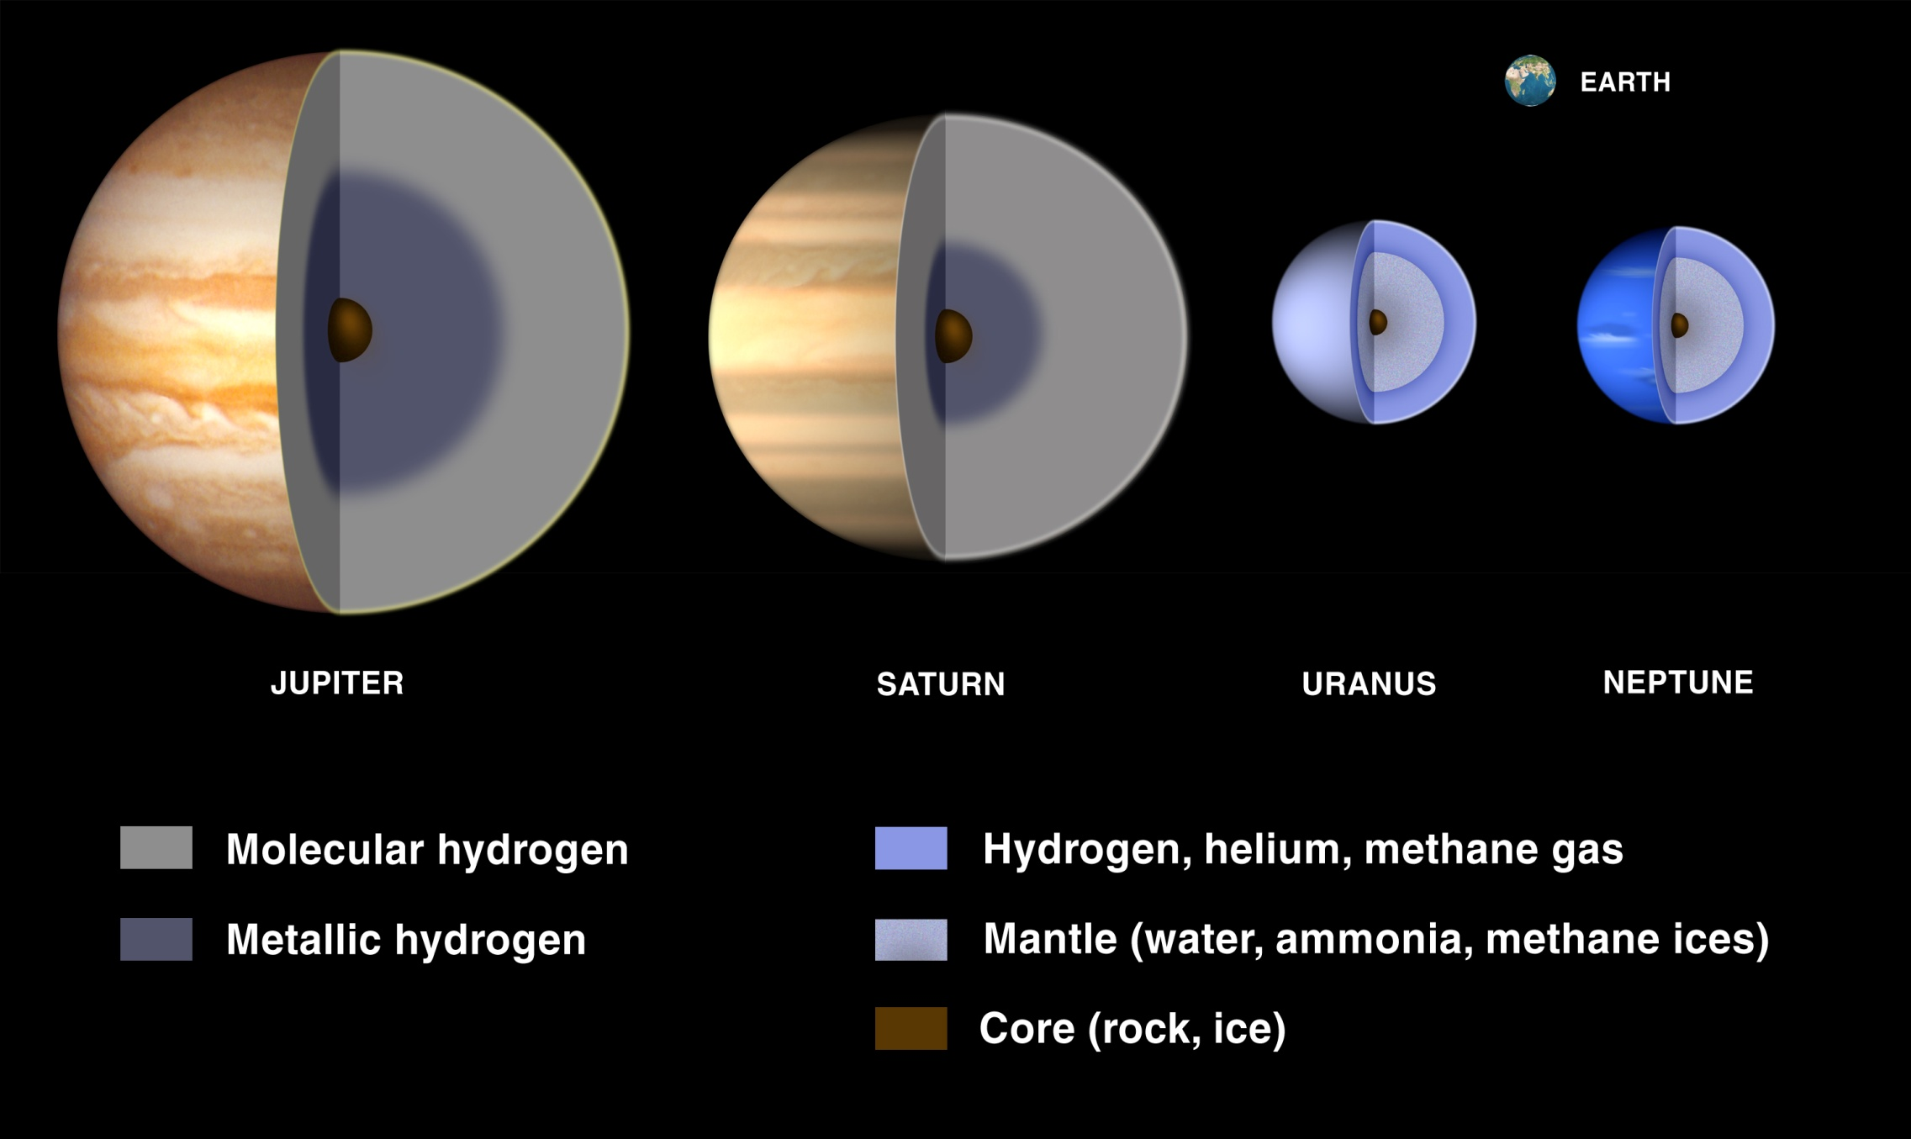
Chapter 7 The Jovian Planets
http://solarsystem.nasa.gov/multimedia/gallery/gas_interiors.jpg
Video

Slide 8
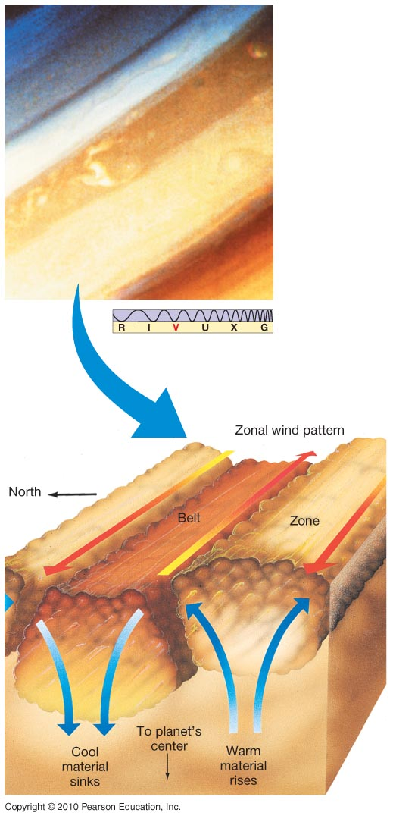
Jupiter’s Atmosphere
Atmosphere has bright zones and dark belts.
Zones are cooler, and are higher than belts.
Stable flow underlies zones and bands, called zonal flow.
Simplified model:

Slide 9
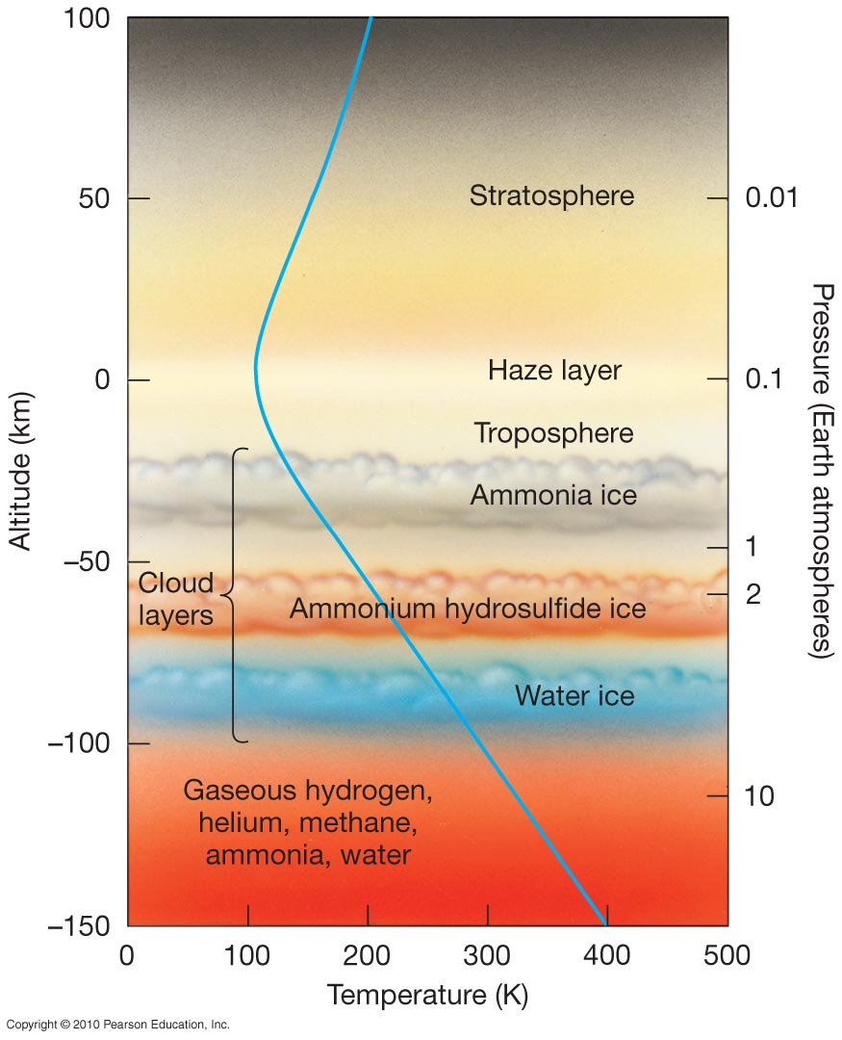
Jupiter’s Atmosphere
No solid surface; take top of troposphere to be 0 km.
Lowest cloud layer cannot be seen by optical telescopes.
Measurements by Galileo probe show high wind speeds even at great depth – probably due to heating from planet, not from Sun.

Slide 10
Know the 3 cloud layers and their altitudes

Slide 11
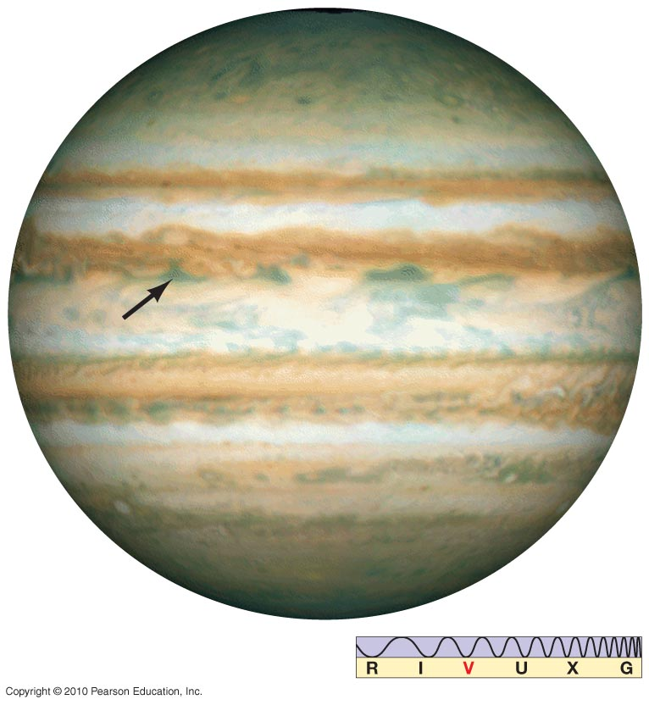
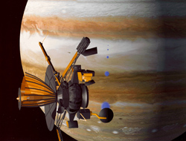
Jupiter’s Atmosphere
The Galileo probe descended into Jupiter’s atmosphere and returned valuable data. The arrow indicates its entry point.
Probe

Slide 12
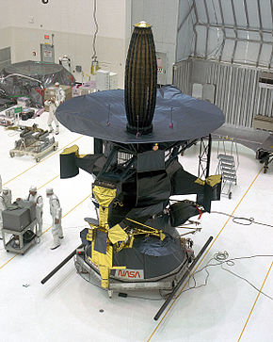
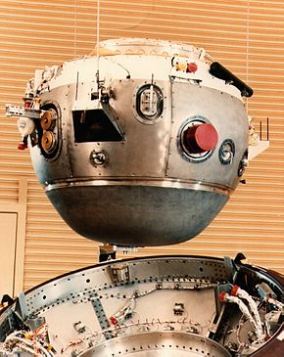
Galileo & Probe $1.6 Billion 1989 - 2003

Slide 13
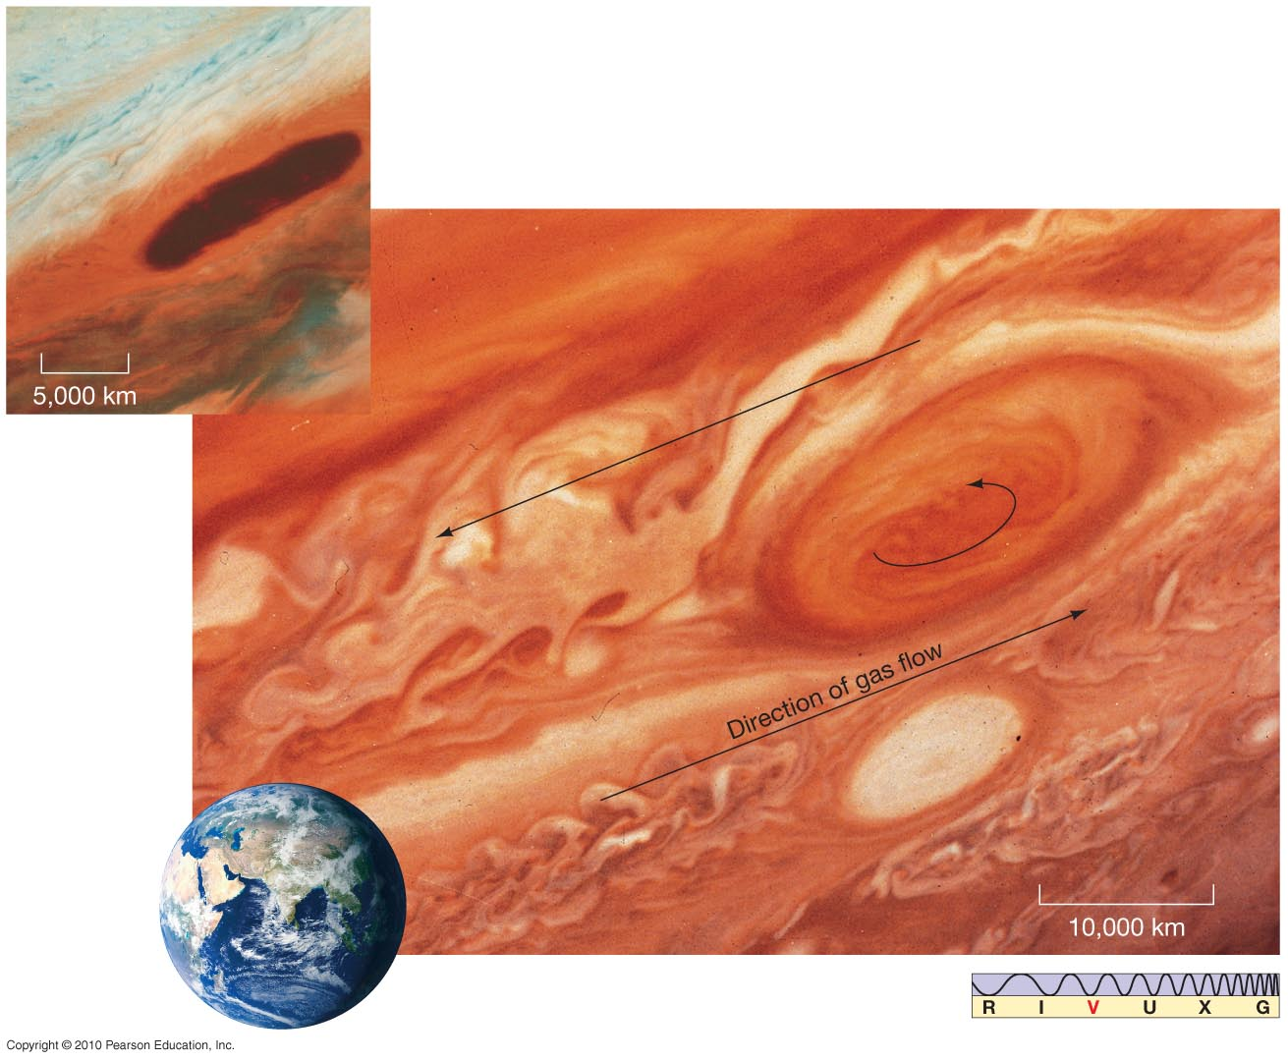
Jupiter’s Atmosphere
Major visible features:
Bands of clouds; Great Red Spot
Red spot

Slide 14
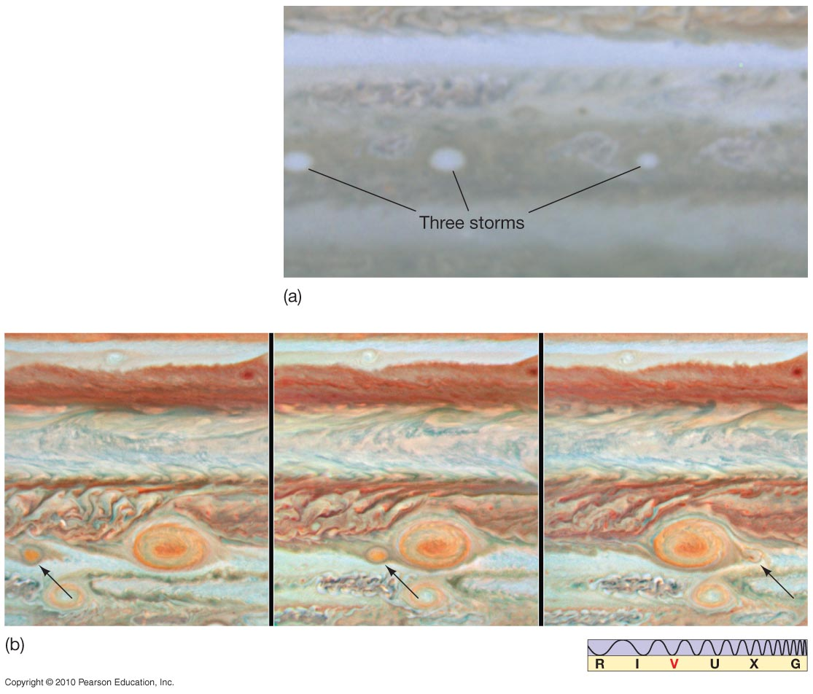
Jupiter’s Atmosphere
Two examples of smaller storms merging, first into a smaller red spot, second into existing Great Red Spot

Slide 15
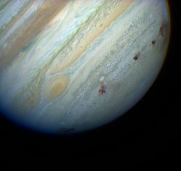
Comet Shoemaker-Levy 9
1994-first comet orbiting a planet(captured ~20-30y prior)

Slide 16
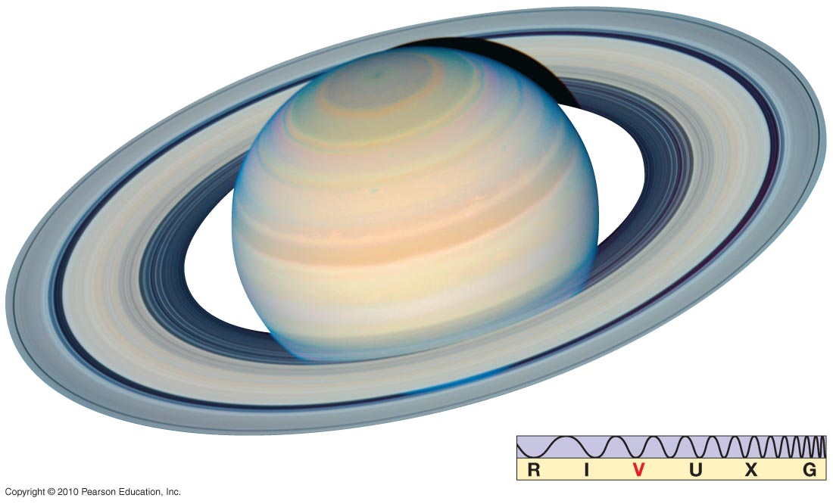
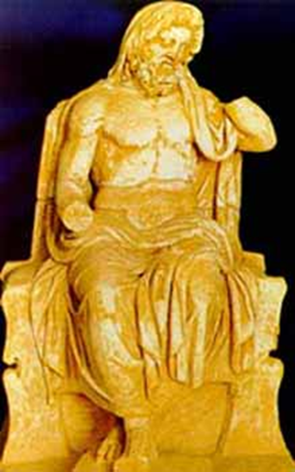
Observations of Jupiter and Saturn
Natural-color image Saturn - Roman god of agriculture

Slide 17
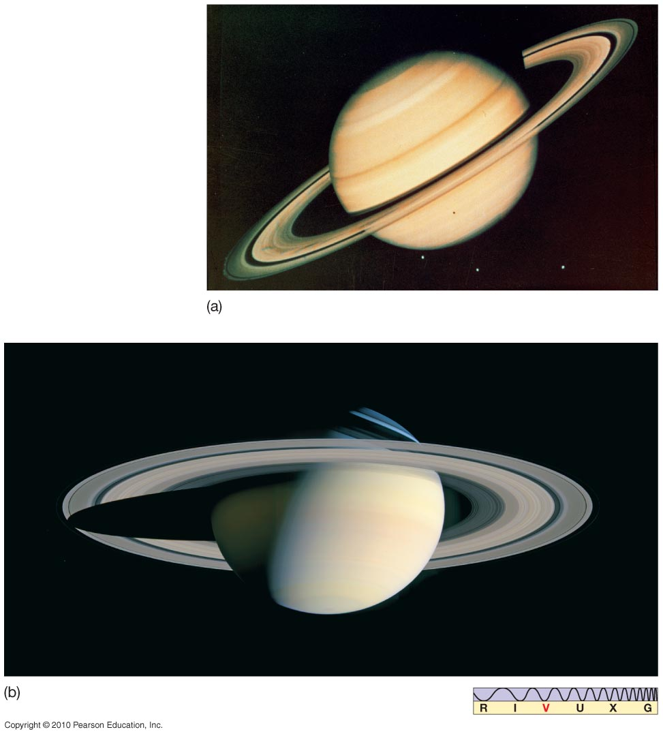
The Atmospheres of the Outer Jovian Worlds
The atmosphere of Saturn is similar to that of Jupiter, except that Saturn is somewhat colder and its atmosphere is thicker.

Slide 18
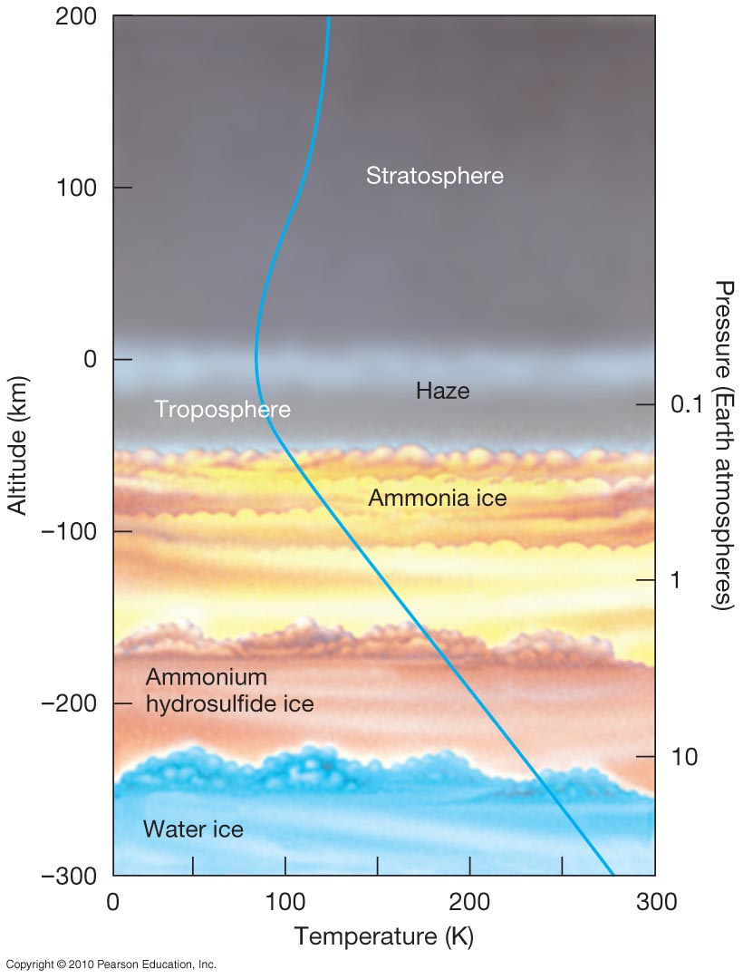
The Atmospheres of the Outer Jovian Worlds
Saturn’s atmosphere is similar to Jupiter’s, except pressure is lower.
It has three cloud layers.
Cloud layers are thicker than Jupiter’s; see only top layer.

Slide 19
Know the 3 cloud layers and their altitudes

Slide 20
The Atmospheres of the Outer Jovian Worlds
Saturn also has large storms, and bands.

Slide 21
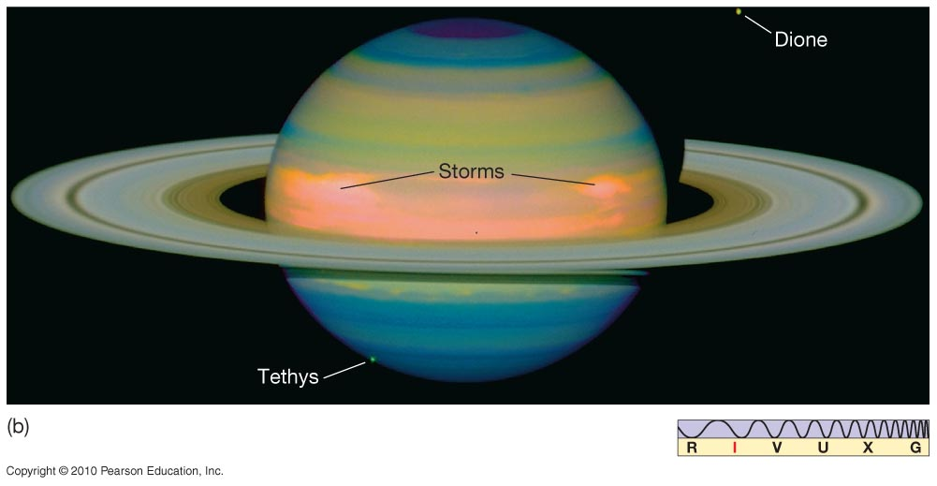
The Atmospheres of the Outer Jovian Worlds
Storms near Saturn’s equator

Slide 22
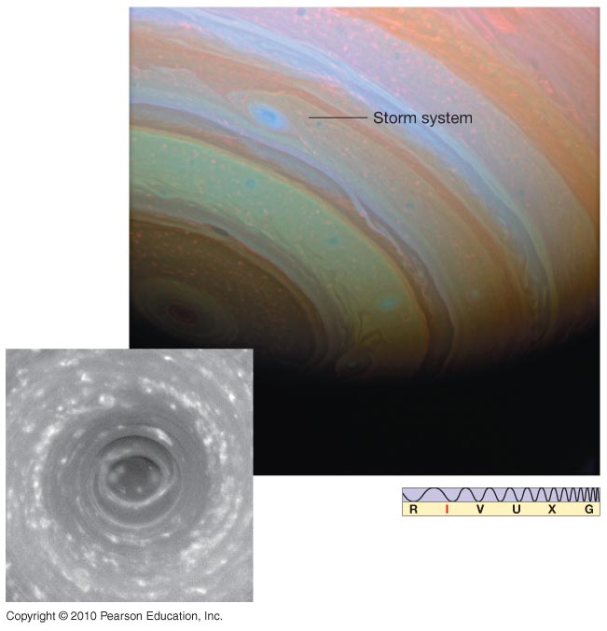
The Atmospheres of the Outer Jovian Worlds
Enormous thunderstorm on Saturn

Slide 23
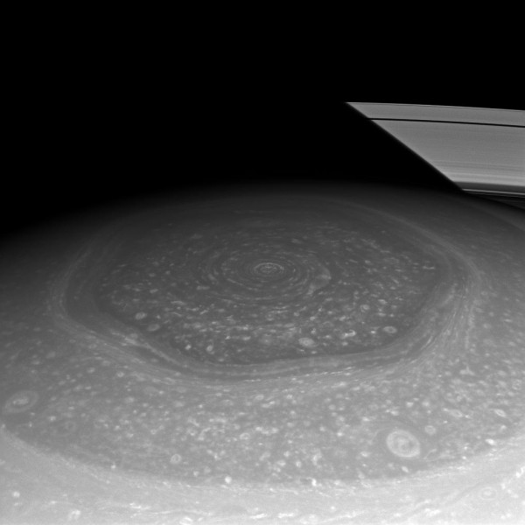
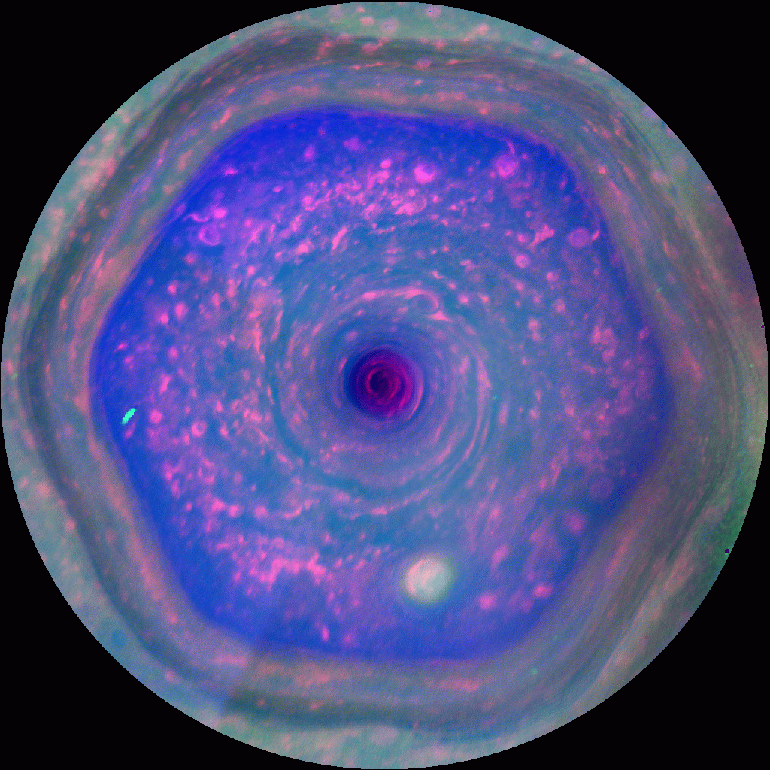
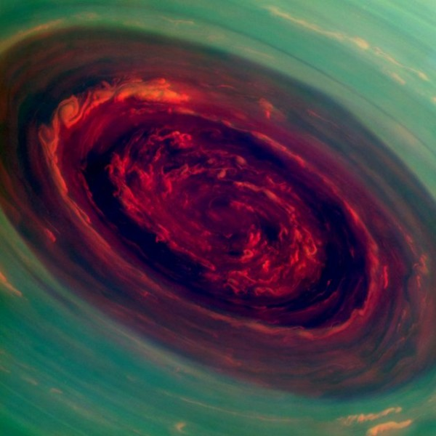
Saturn North Pole(Hexagonal Storm)

Slide 24
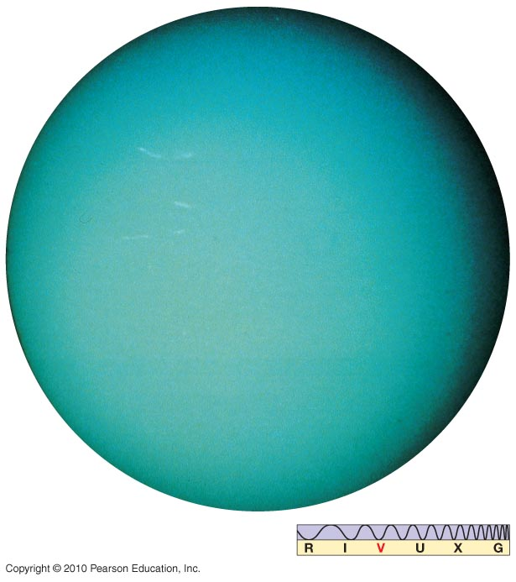
The Discoveries of Uranus and Neptune
Uranus, in natural color. Note the absence of features.
Discovered in 1781 William Herschel
Wanted to name it George.
Photo Voyager 2 1986
Greek god of the sky.

Slide 25
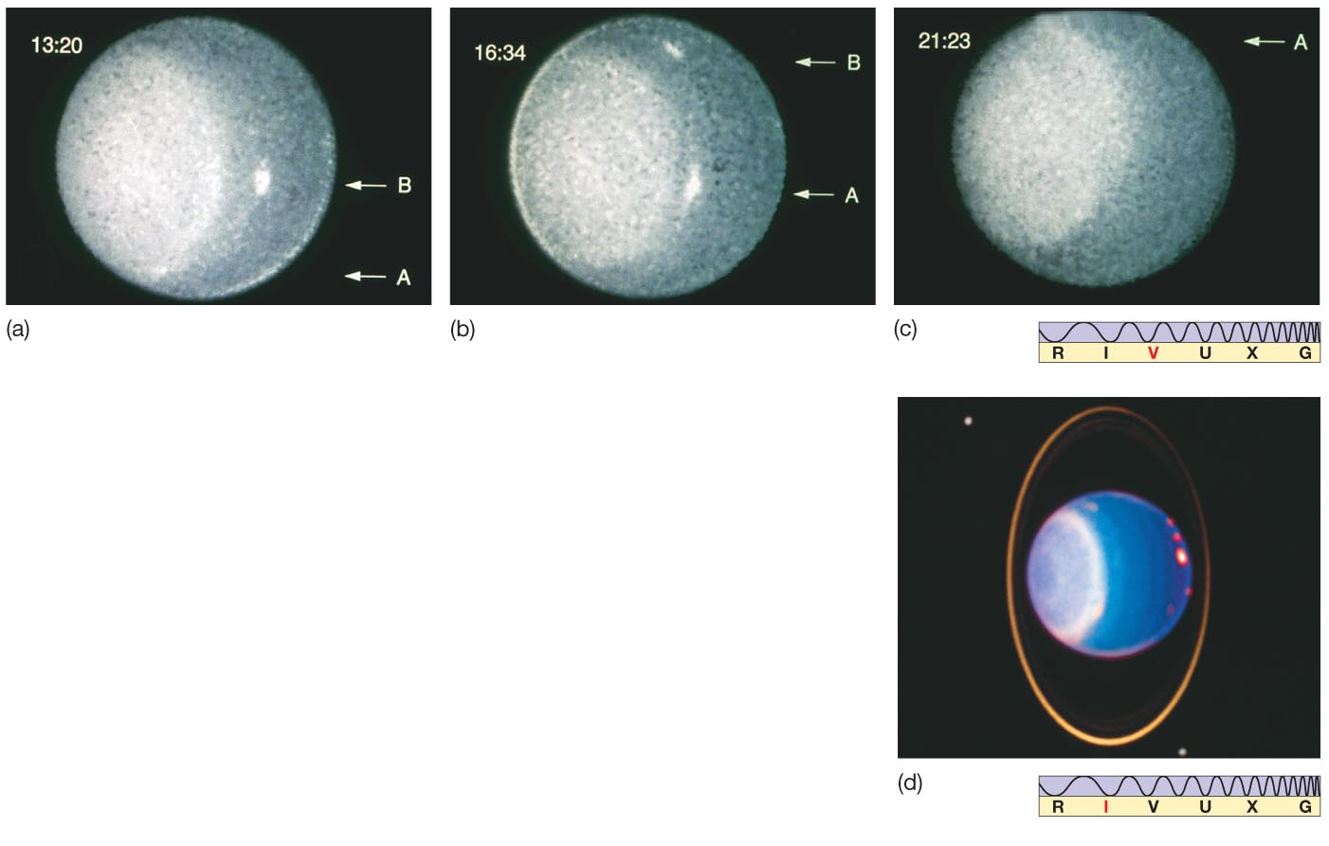
The Atmospheres of the Outer Jovian Worlds
Rotation of Uranus can be measured by watching storms.

Slide 26
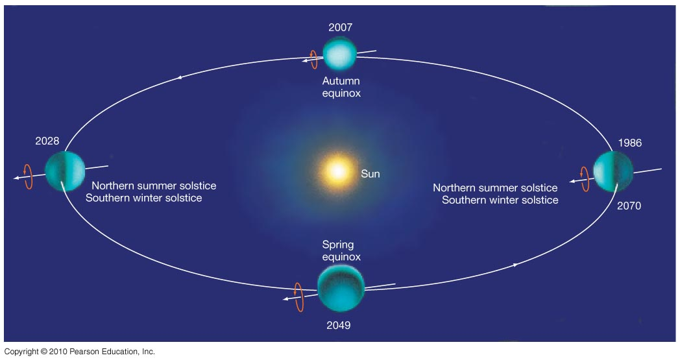
Jovian Planets
Peculiarity of Uranus: Axis of rotation lies almost in the plane of its orbit. Seasonal variations are extreme.

Slide 27
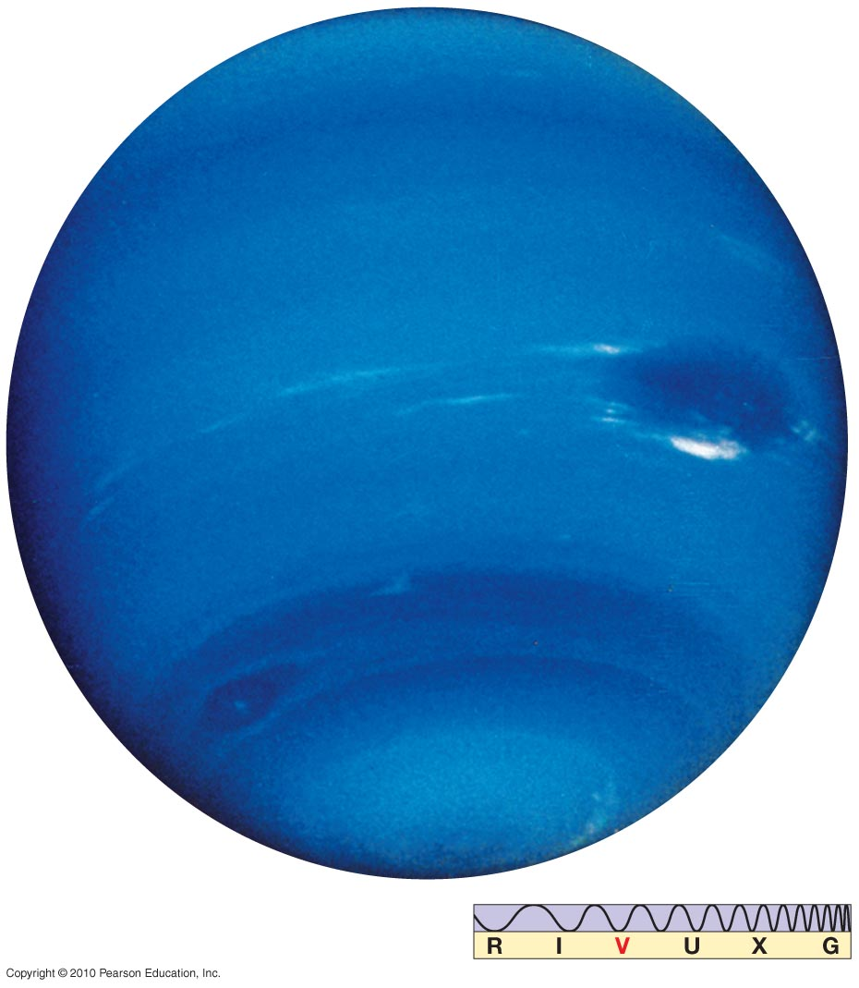
The Discoveries of Uranus and Neptune
Neptune in natural color
1846 Johann Galle
Voyager 2 image
1989
Roman god of the sea

Slide 28
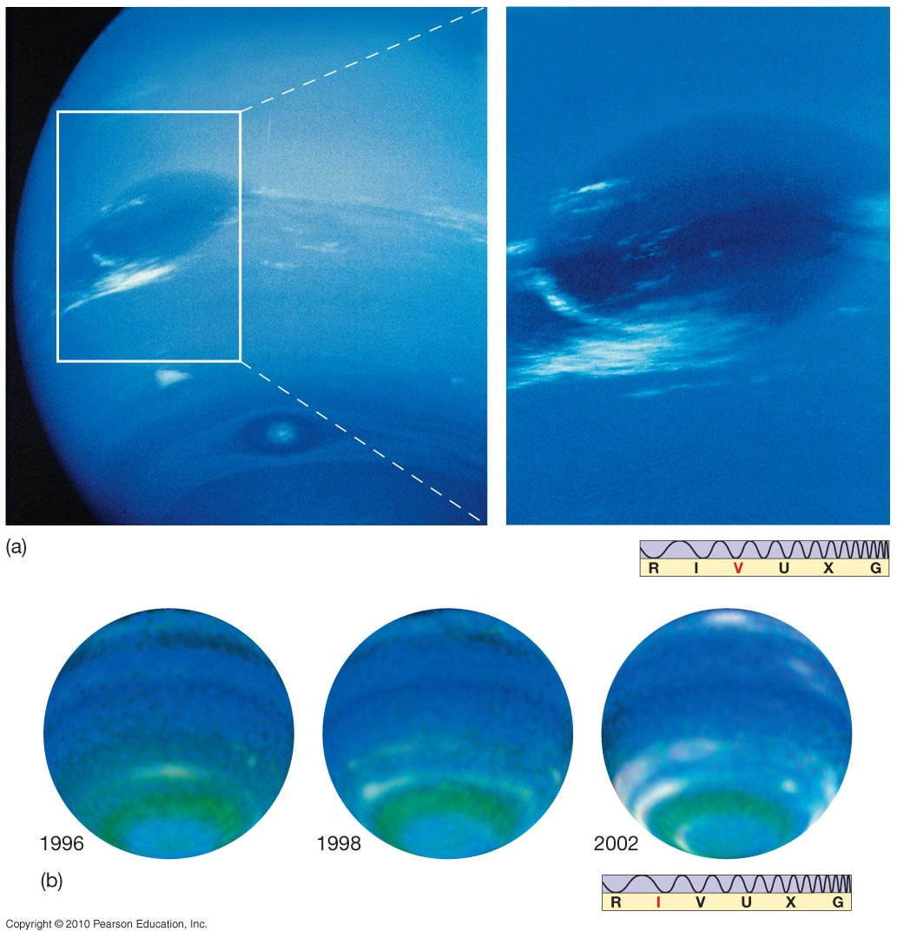
The Atmospheres of the Outer Jovian Worlds
Neptune has storm systems similar to those on Jupiter, but fewer. The large storm system at top has disappeared in recent years.

Slide 29
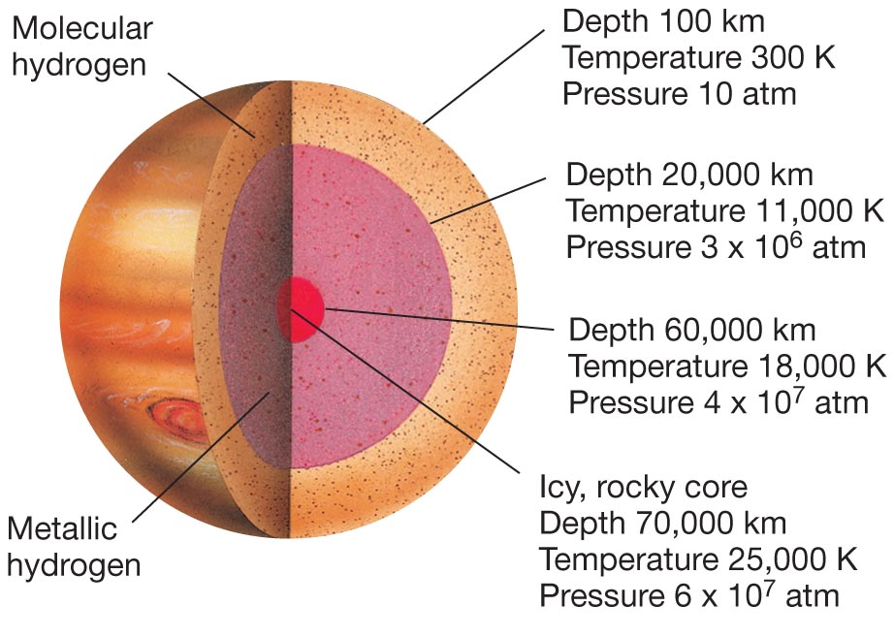
Jovian Interiors
No direct information is available about Jupiter’s interior, but its main components, molecular hydrogen and metallic hydrogen are below the cloud layers. The core is thought to be a rocky/icy.

Slide 30
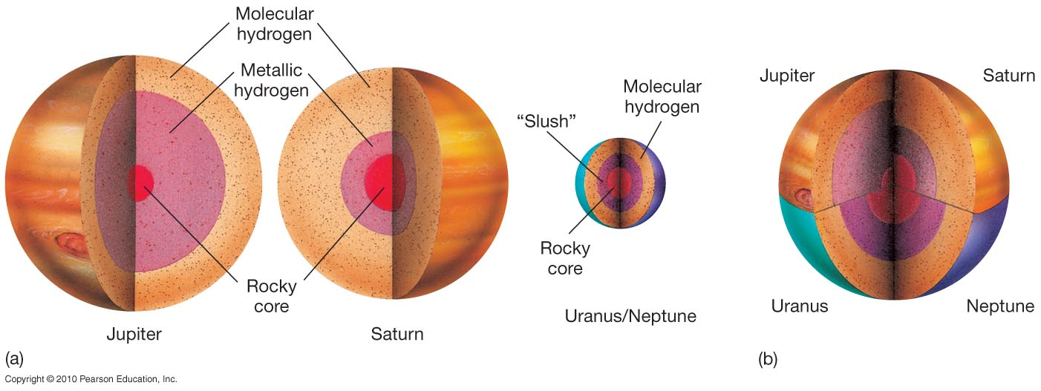
Jovian Interiors
Magnetic fields of Uranus and Neptune must not be produced by dynamos, as the other planets’ fields are.
Interior structure of Uranus and Neptune, compared to that of Jupiter and Saturn:

Slide 31
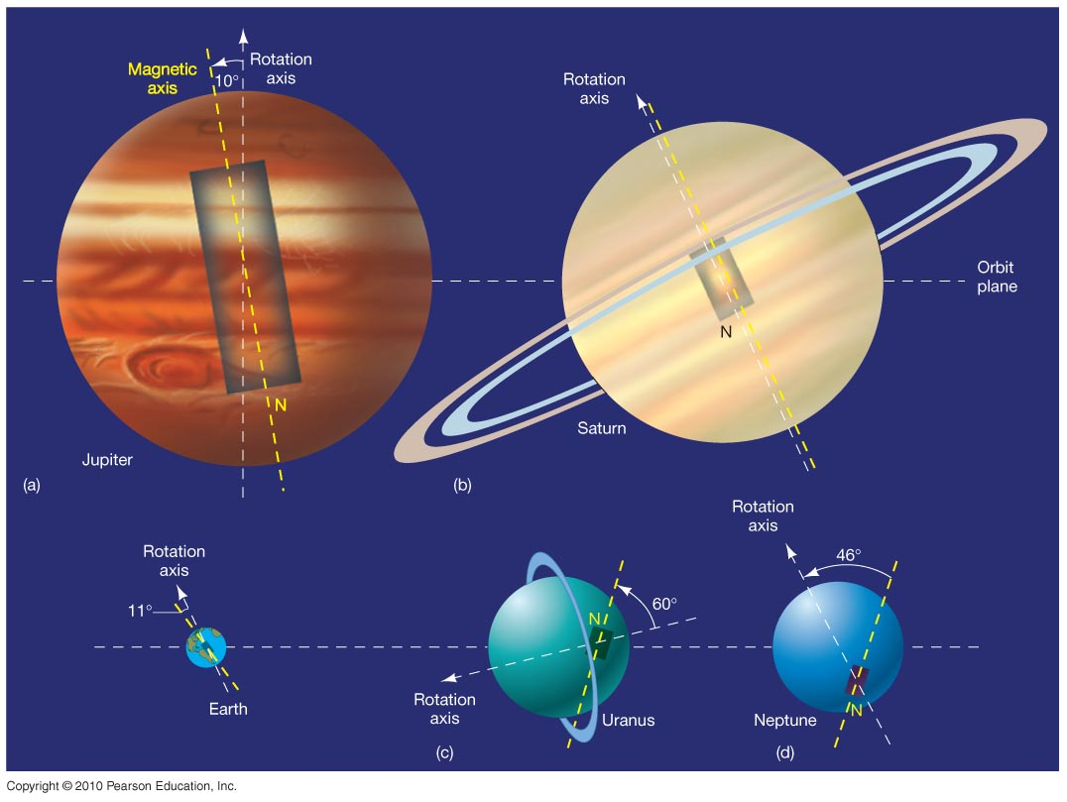
Jovian Interiors
Uranus and Neptune both have substantial magnetic fields, but at a large angle to their rotation axes.
The rectangle within each planet shows a bar magnet that would produce a similar field. Note that both Uranus’s and Neptune’s are significantly off center.

Slide 32
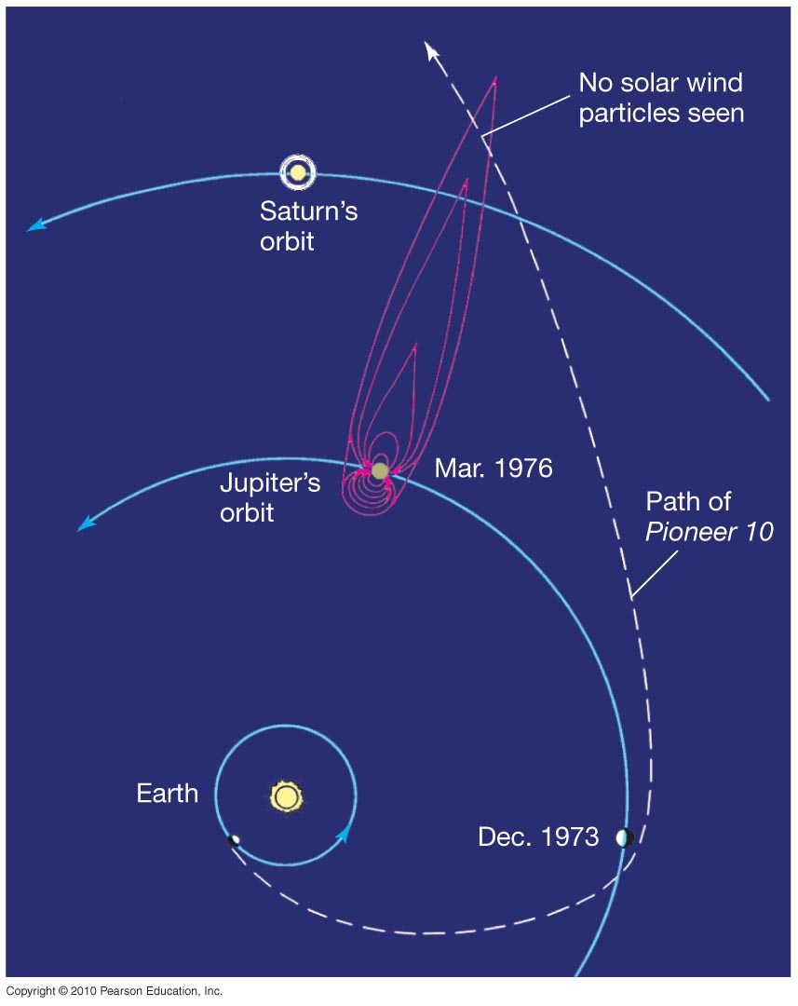
Jovian Interiors
Jupiter’s magnetosphere:
Intrinsic field strength is 20,000 times that of Earth.
Magnetosphere can extend beyond the orbit of Saturn.

Slide 33
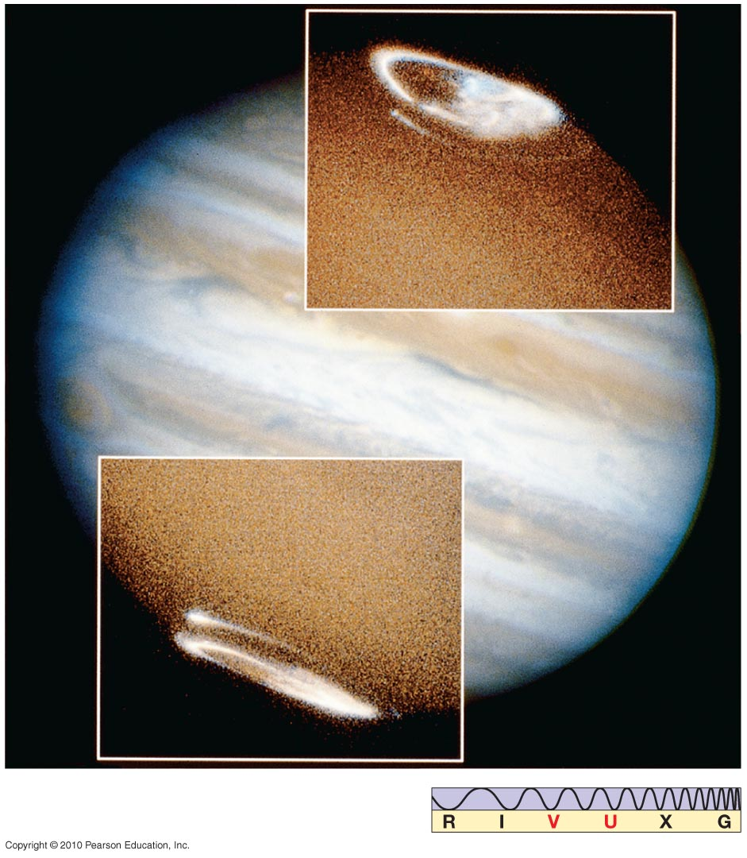
Jovian Interiors
Aurorae are seen on Jupiter, and have the same cause as those on Earth – the interaction of solar wind particles with the magnetosphere.

Slide 34
END

