Slide 1
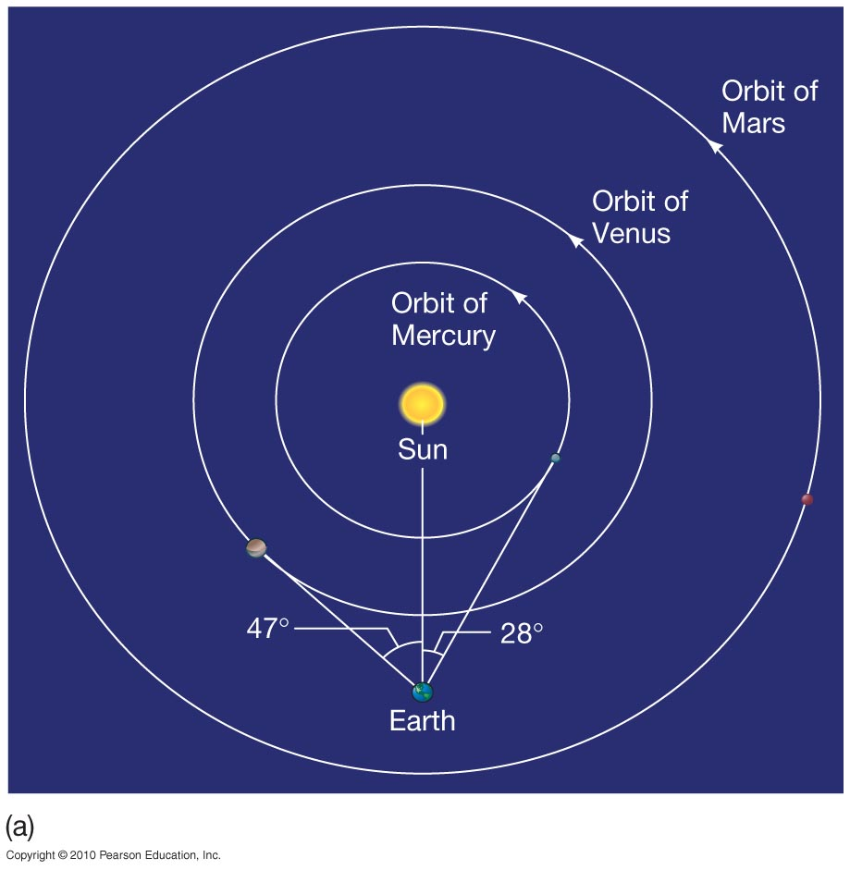
Orbital and Physical Properties
The orbits of Venus and Mercury show that these planets never appear far from the Sun.

Slide 2
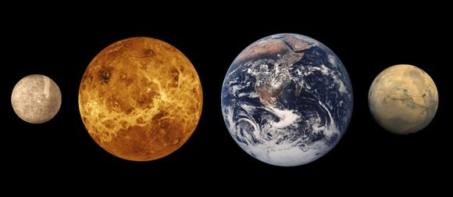
Orbital and Physical Properties
The terrestrial planets have similar densities and roughly similar sizes, but their rotation periods, surface temperatures, and atmospheric pressures vary widely.

Slide 3
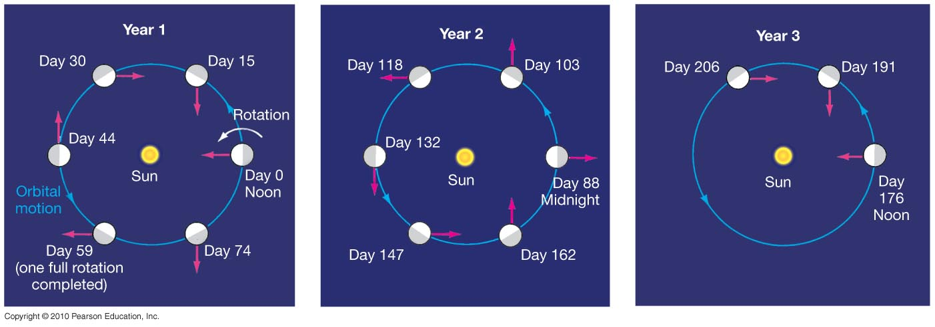
Rotation Rates
Mercury was long thought to be tidally locked to the Sun; measurements in 1965 showed this to be false.
Rather, Mercury’s day and year are in a 3:2 resonance; Mercury rotates three times while going around the Sun twice.

Slide 4
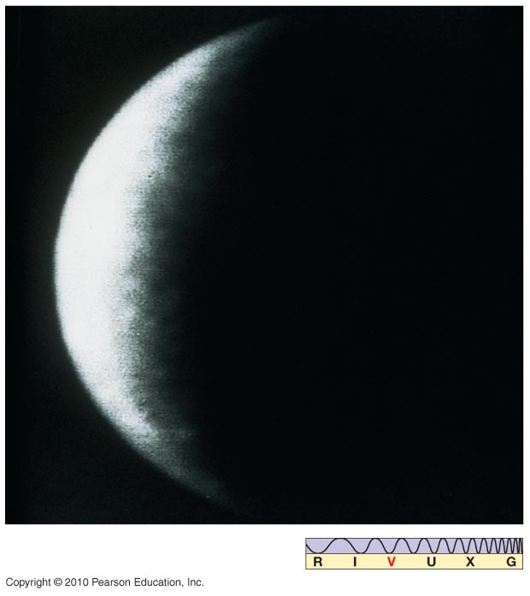
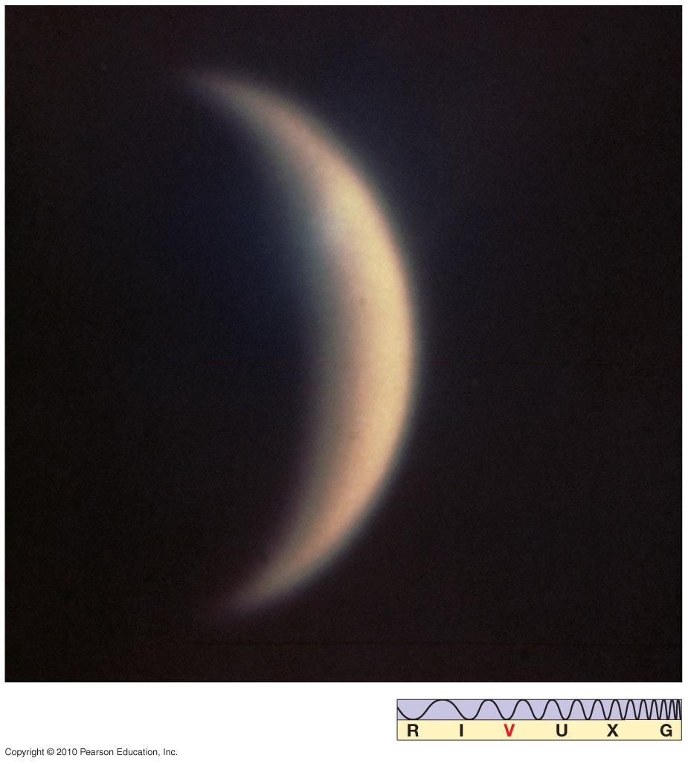
Rotation Rates
Mercury
Venus
59 days
-243 days

Slide 5
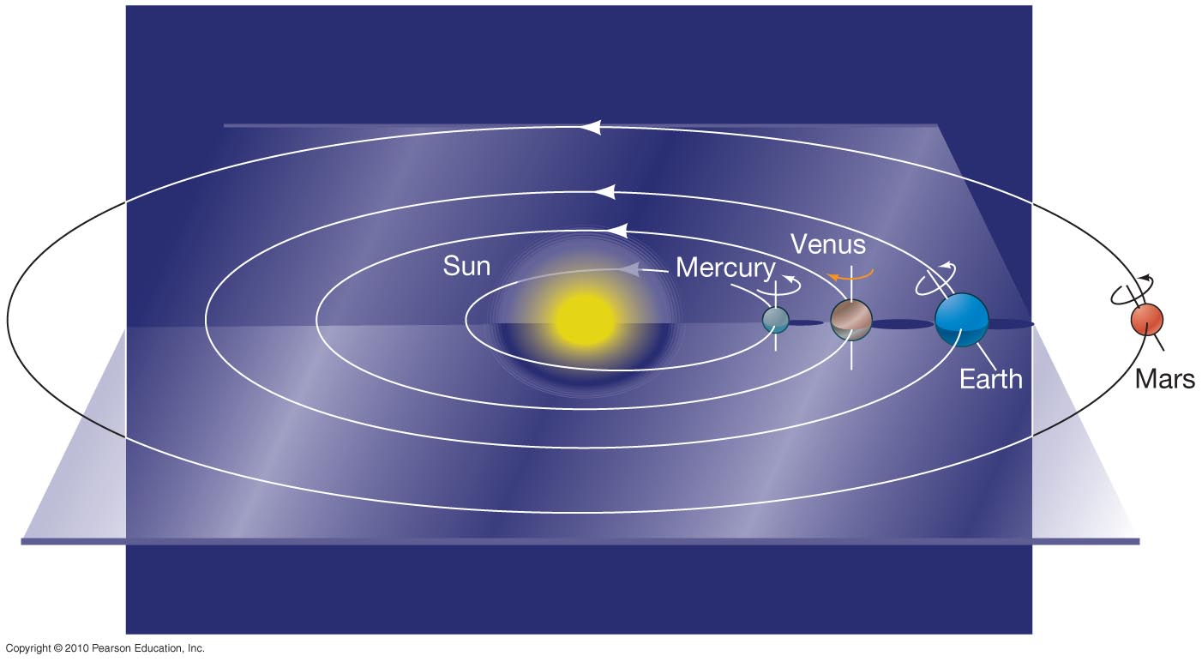
Rotation Rates
All the planets rotate in a prograde direction(CCW), except Venus, which is retrograde(CW).

Slide 6
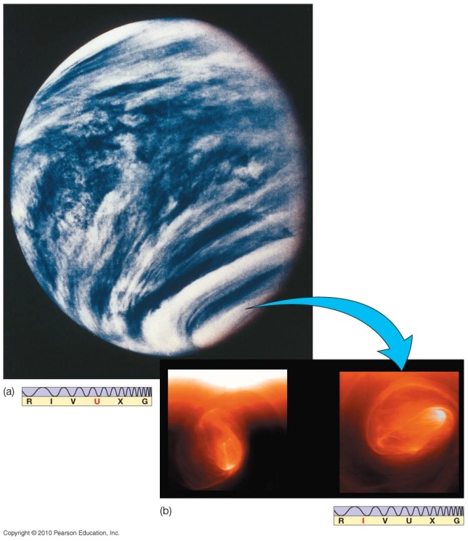
Atmospheres
Mercury has no detectable atmosphere; it is too hot, too small, and too close to the Sun.
Venus has an extremely dense atmosphere. The outer clouds are similar in temperature to Earth, and it was once thought that Venus was a “jungle” planet. We now know that its surface is hotter than Mercury’s, hot enough to melt lead.

Slide 7
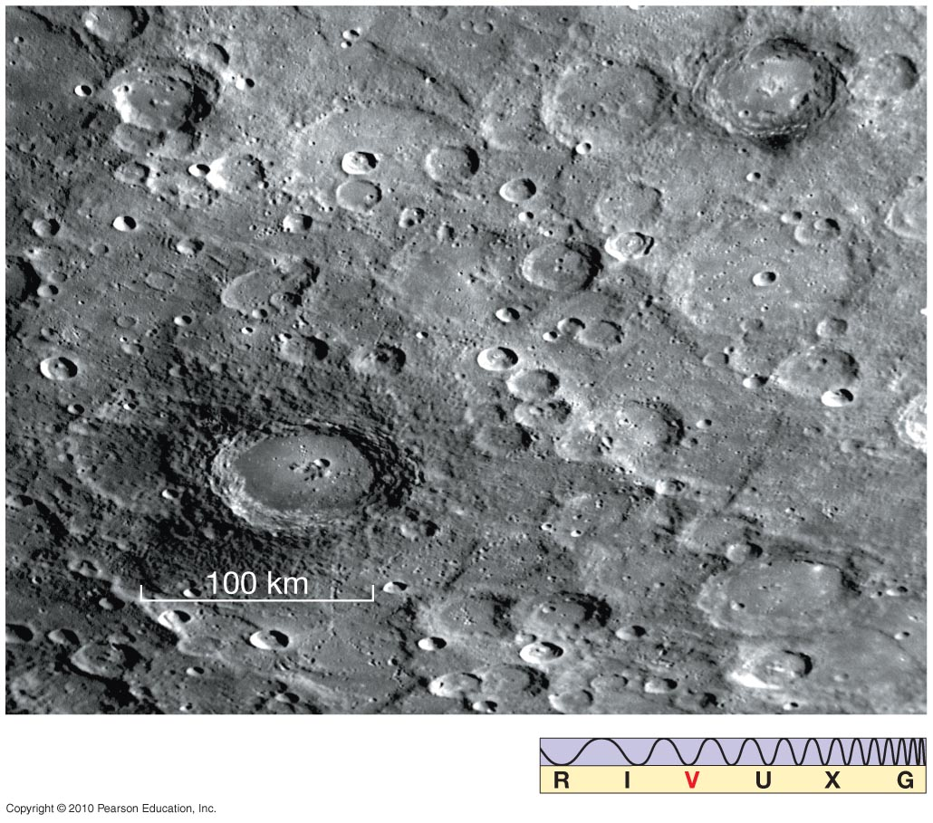
The Surface of Mercury
Mercury cannot be imaged well from Earth; best pictures are from Messenger.
Cratering on Mercury is similar to that on the Moon.

Slide 8
Basic facts of Mercury
Distance from Sun: 0.3871 au
Eccentricity of orbit: 0.206 (large for major planet)
Inclination of orbit: 7.00 degrees
Diameter: 4878 km (0.38 Earth diameters)
Mass: 0.055 Earth masses
No atmosphere, surface heavily cratered

Slide 9
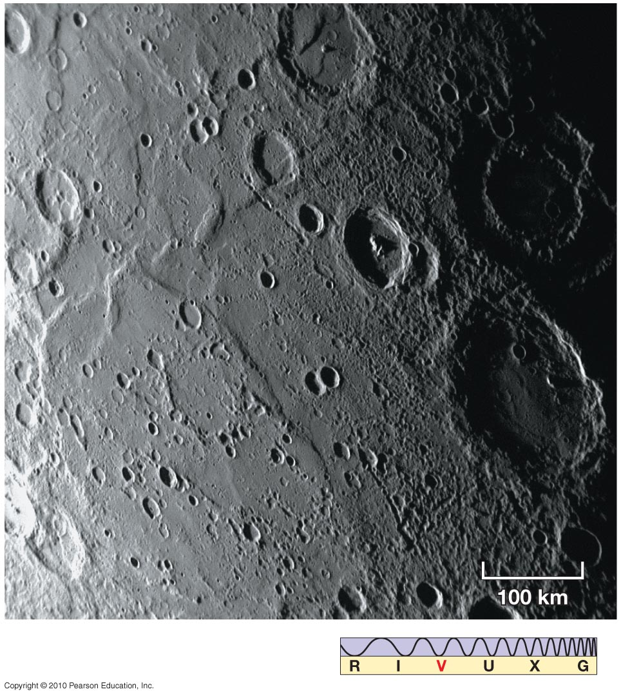
The Surface of Mercury
Some distinctive features: Scarp (cliff), several hundred km long and up to 3 km high, thought to be formed as the planet cooled and shrank.

Slide 10
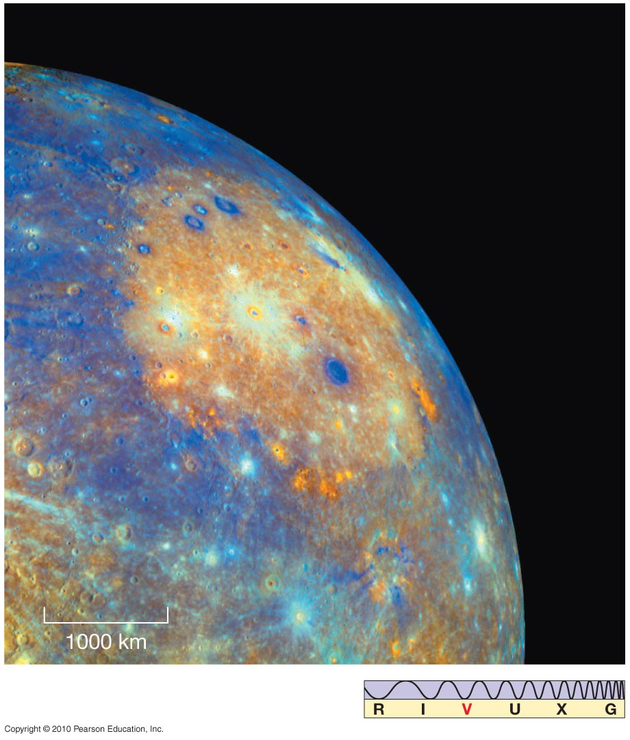
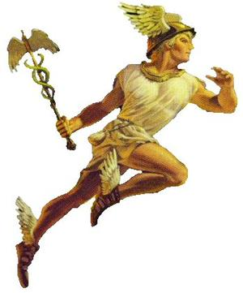
The Surface of Mercury
Caloris Basin, very large impact feature; ringed by concentric mountain ranges

Slide 11
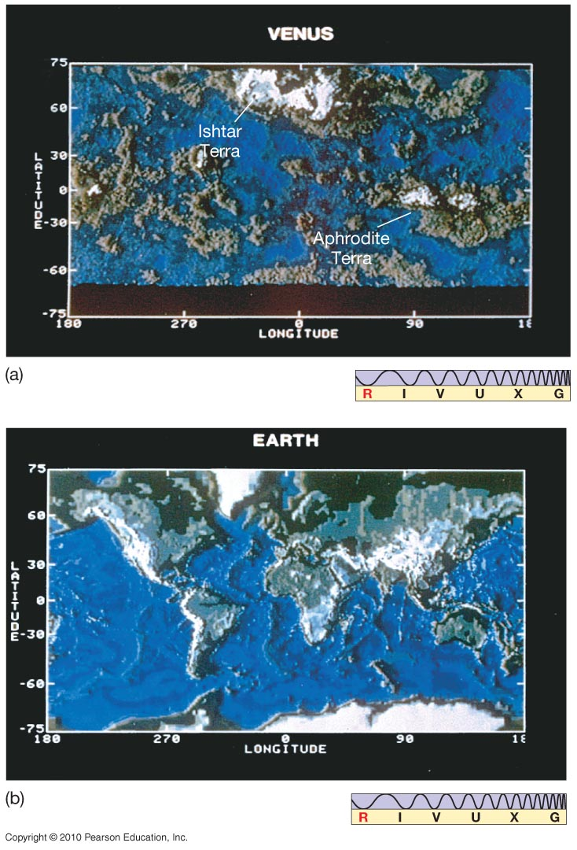
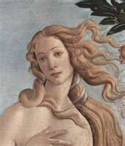
The Surface of Venus
This map of the surface features of Venus is on the same scale as the Earth map below it.

Slide 12
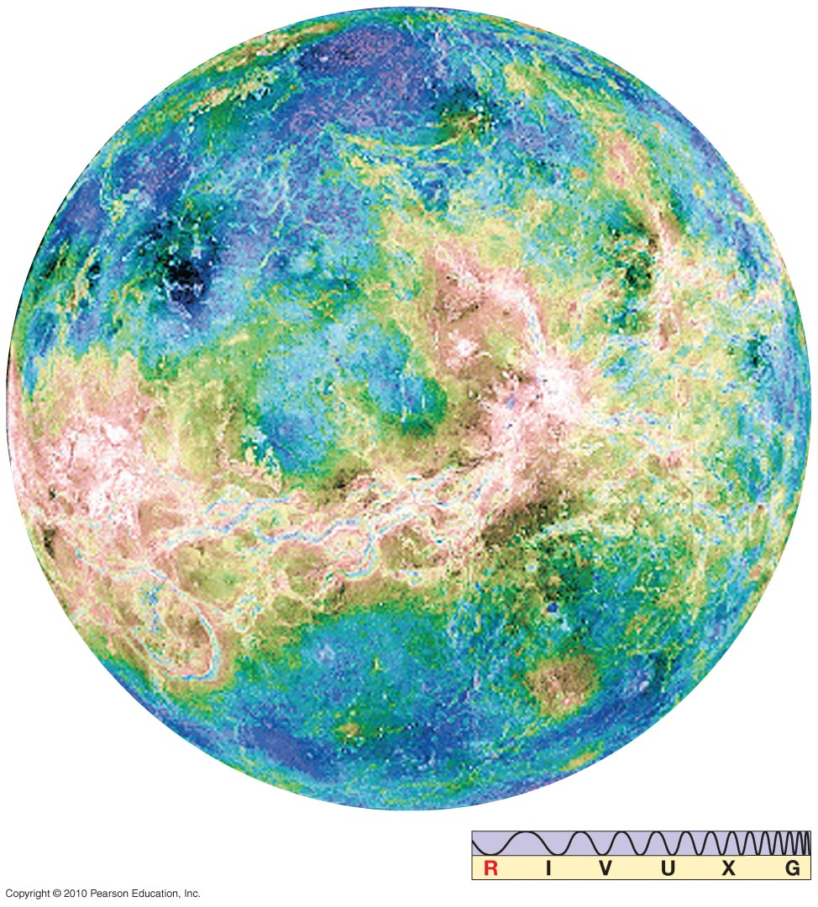
The Surface of Venus
Venus as a globe, imaged by Magellan launched from STS-30 in 1989.
730 k = HOT!
855 F
90 atm
Sulfuric acid rain

Slide 13
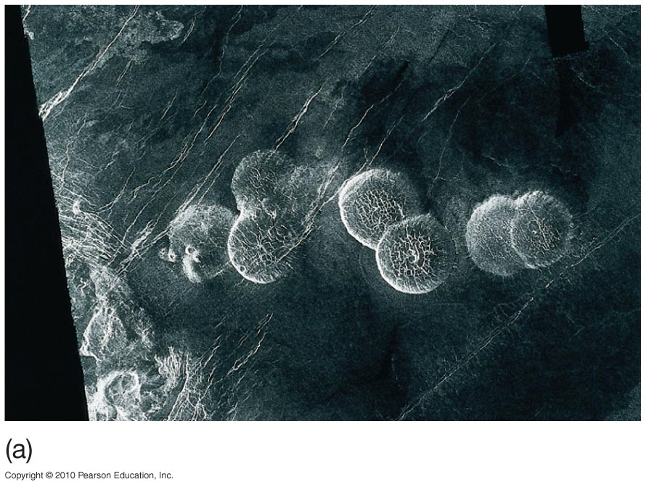
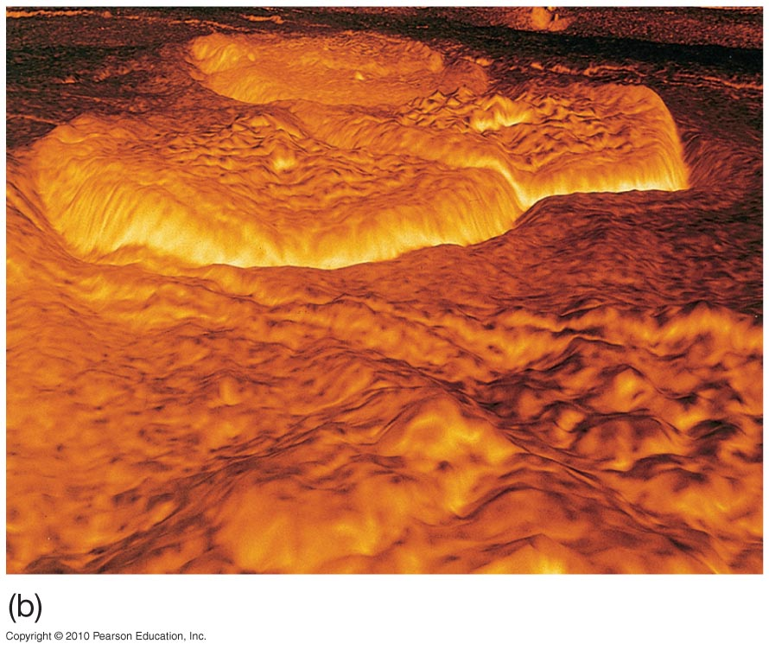
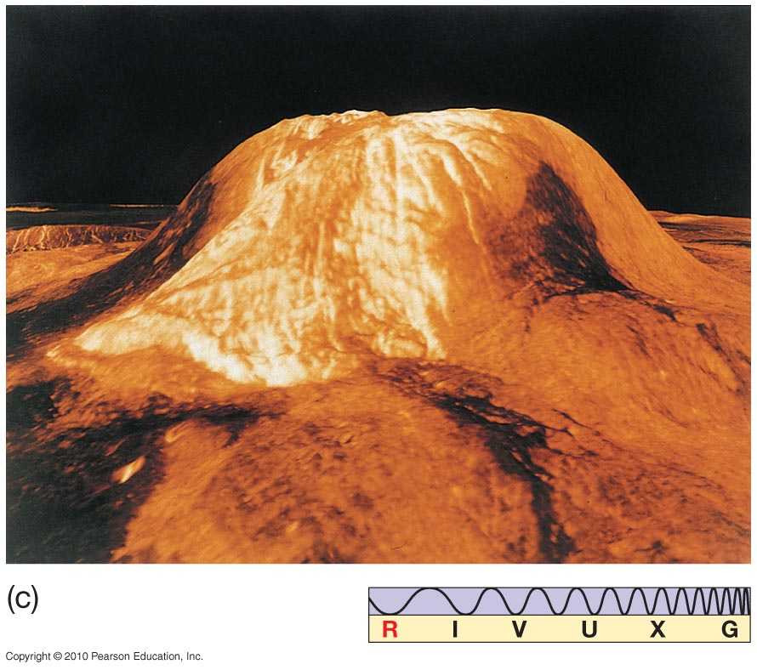
The Surface of Venus
Top: Lava domes on Venus (L), and a computer reconstruction (R)
Bottom: the volcano Gula Mons

Slide 14
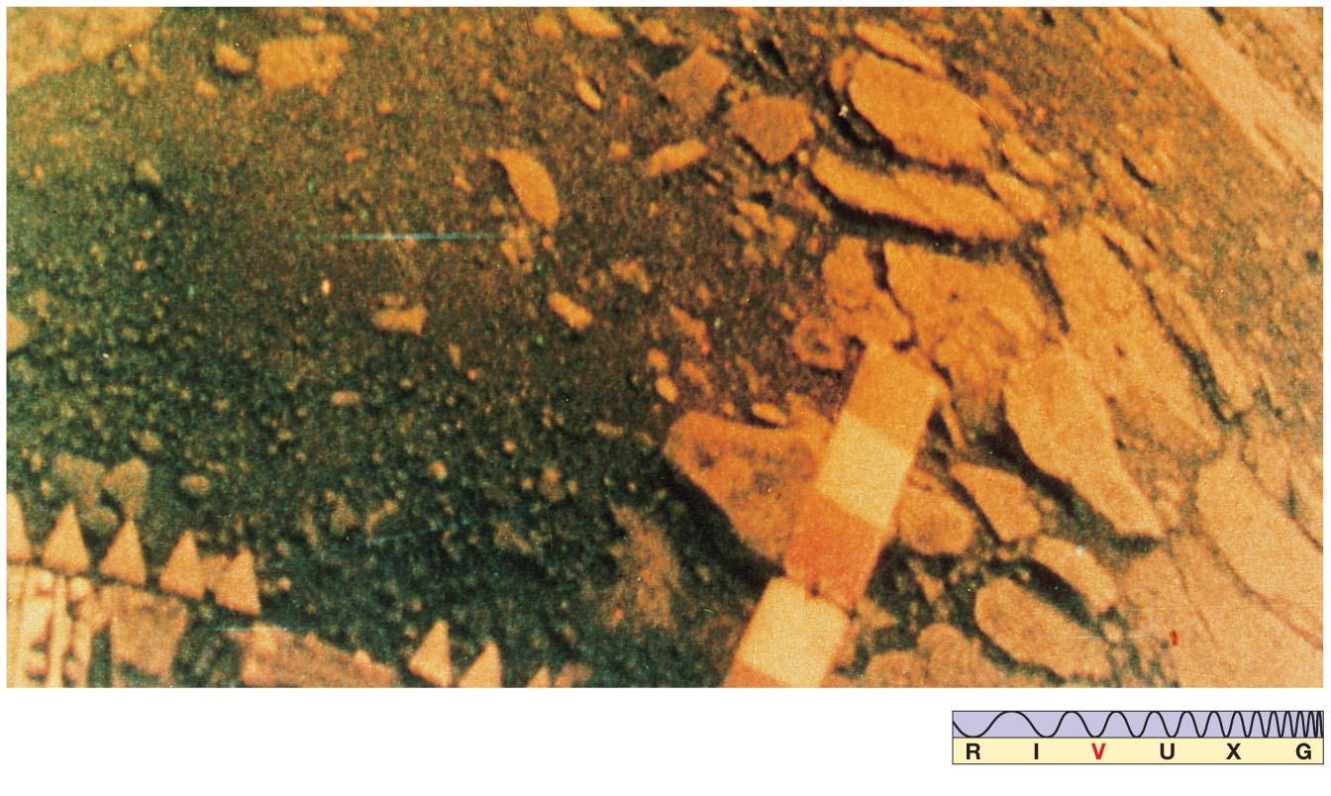
The Surface of Venus
A photograph of the surface, from the Venera lander. Russia sent more than 16 probes.

Slide 15
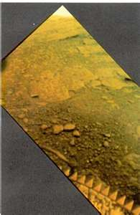
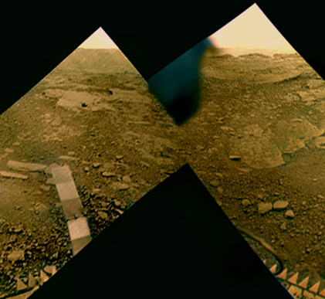
Photography on Venus

Slide 16
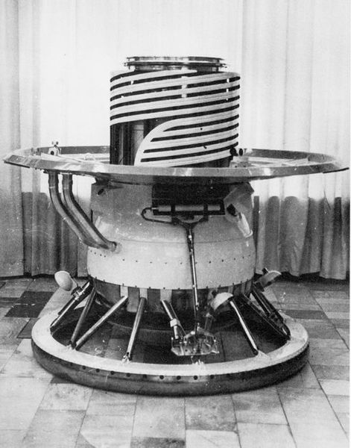
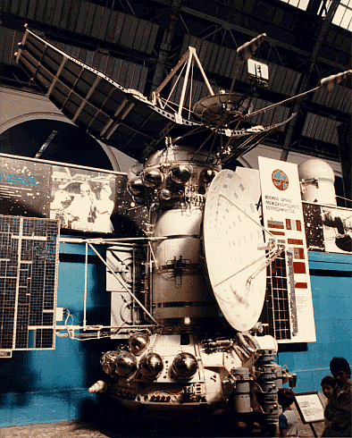
Venera - USSR

Slide 17
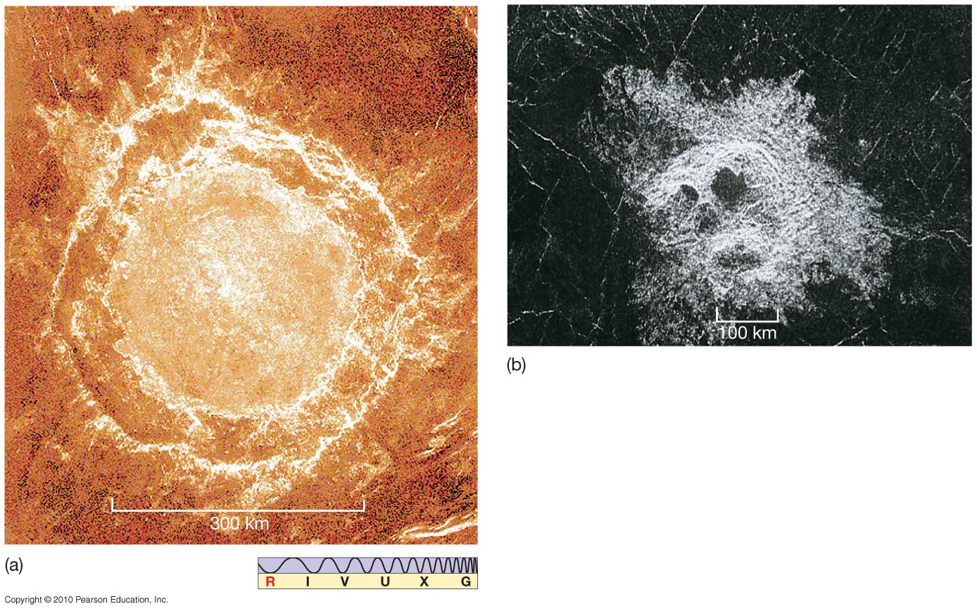
The Surface of Venus
Impact craters. Left: multiple-impact crater Above: Mead, Venus’s largest impact crater

Slide 18
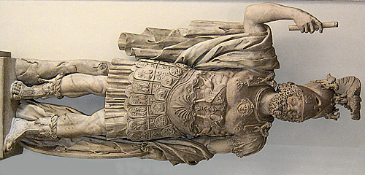
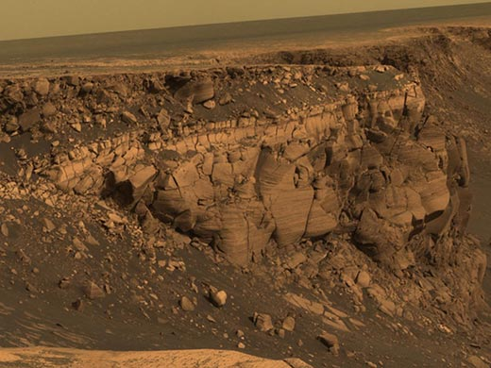
Mars

Slide 19
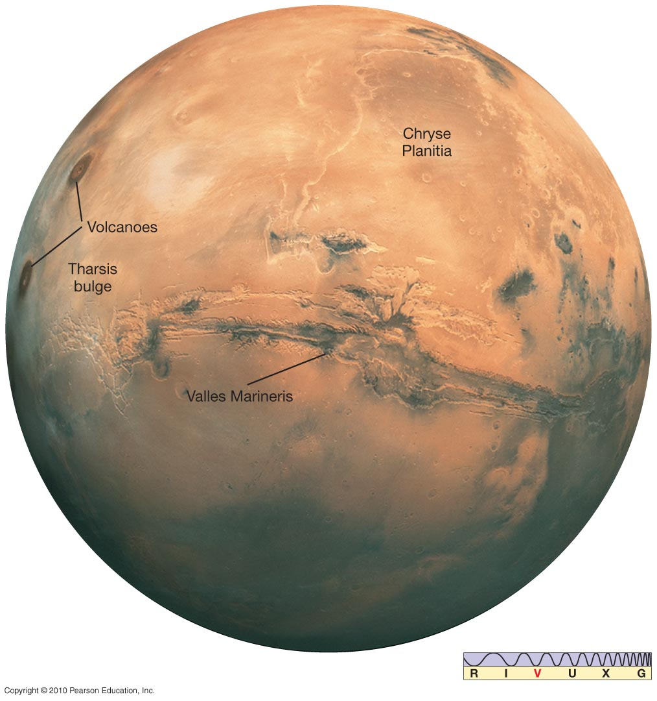
The Surface of Mars
Major feature: Tharsis bulge, size of North America and 10 km above surroundings
Minimal cratering; youngest surface on Mars

Slide 20
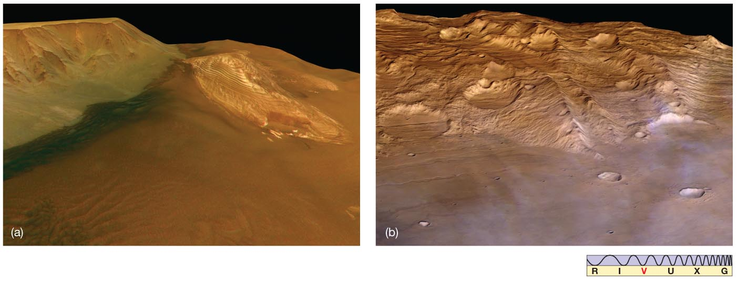
The Surface of Mars
Northern hemisphere (left) is rolling volcanic terrain.
Southern hemisphere (right) is heavily cratered highlands; average altitude 5 km above northern.
Assumption is that northern surface is younger than southern.
Means that northern hemisphere must have been lowered in elevation and then flooded with lava.
Fly by

Slide 21
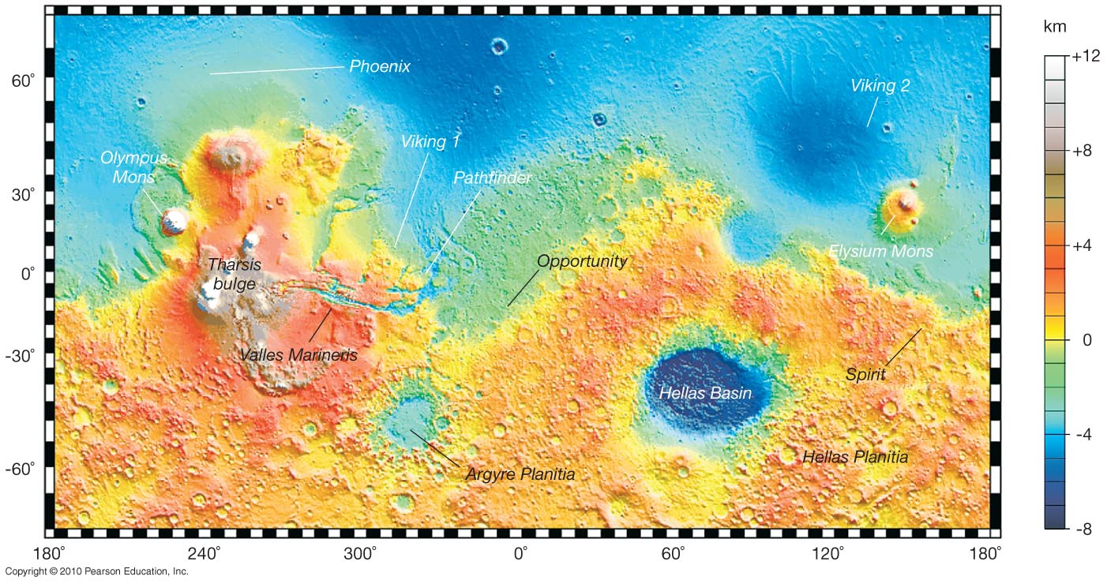
The Surface of Mars
This map shows the main surface features of Mars. There is no evidence for plate tectonics.

Slide 22
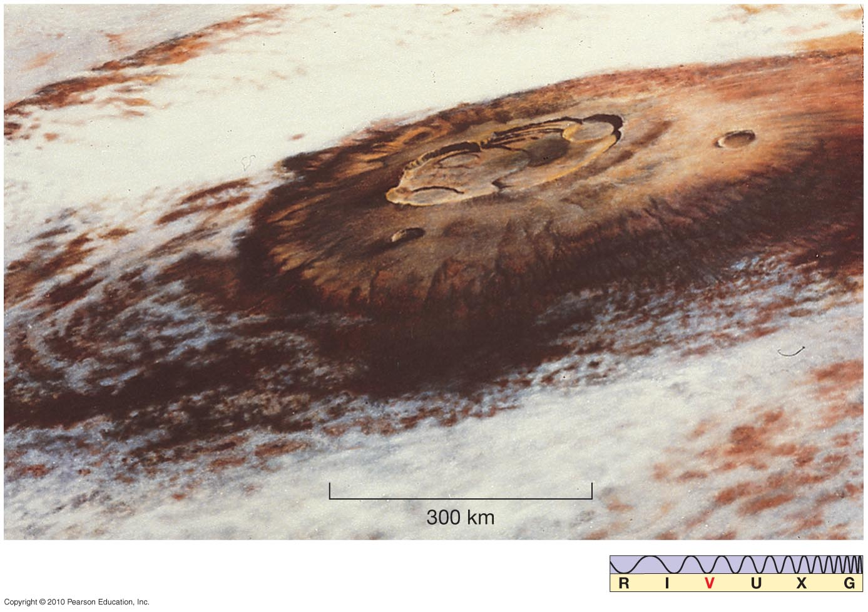
The Surface of Mars
Mars has largest volcano in Solar System; Olympus Mons:
700 km diameter at base
25 km high
Caldera 80 km in diameter
Three other Martian volcanoes are only slightly smaller.

Slide 23
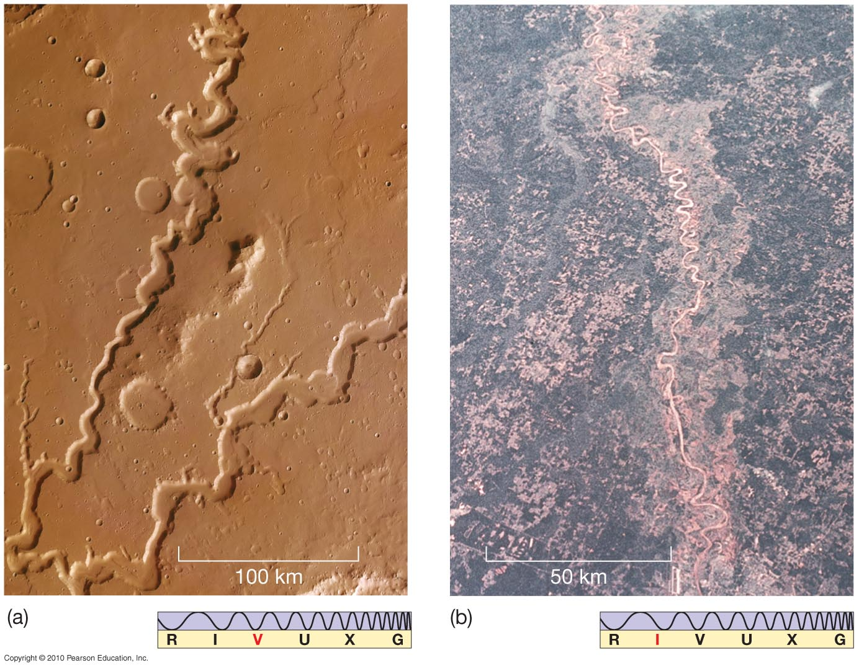
The Surface of Mars
Was there running water on Mars?
Runoff channels resemble those on Earth.
Left: Mars
Right: Earth

Slide 24
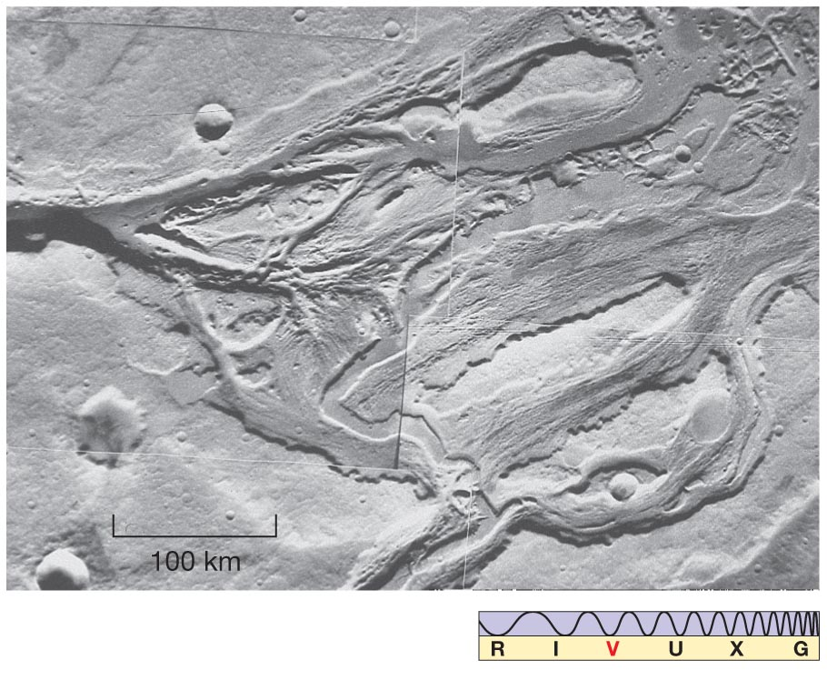
The Surface of Mars
No evidence of connected river system; features probably due to flash floods

Slide 25
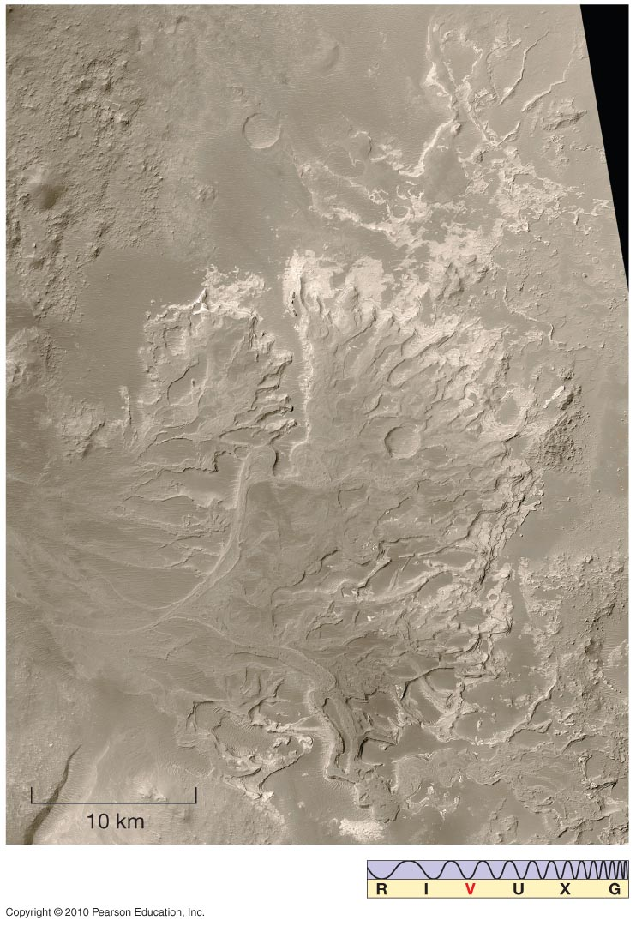
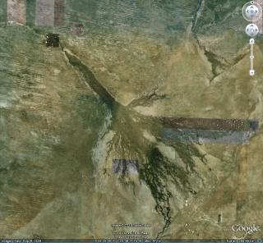
The Surface of Mars
This feature may be an ancient river delta. Or it may be something entirely different.
Okavango

Slide 26
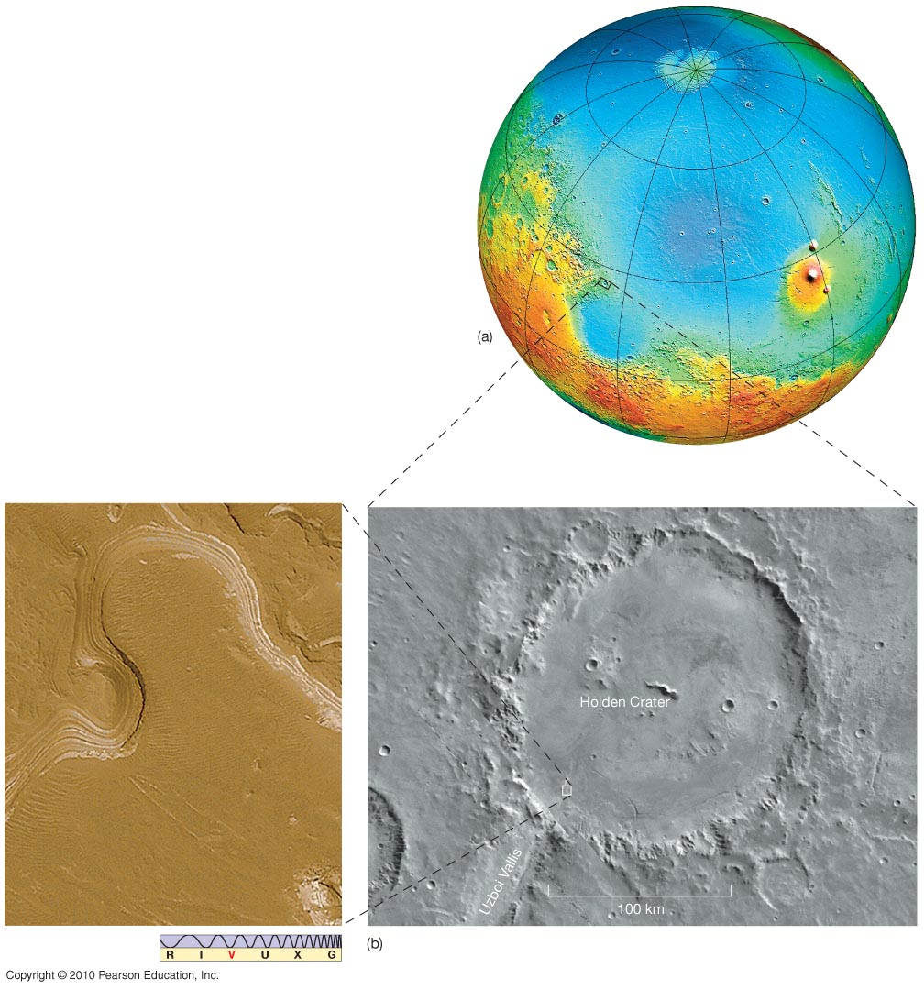
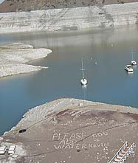
6.6 The Surface of Mars
Much of northern hemisphere may have been ocean.

Slide 27
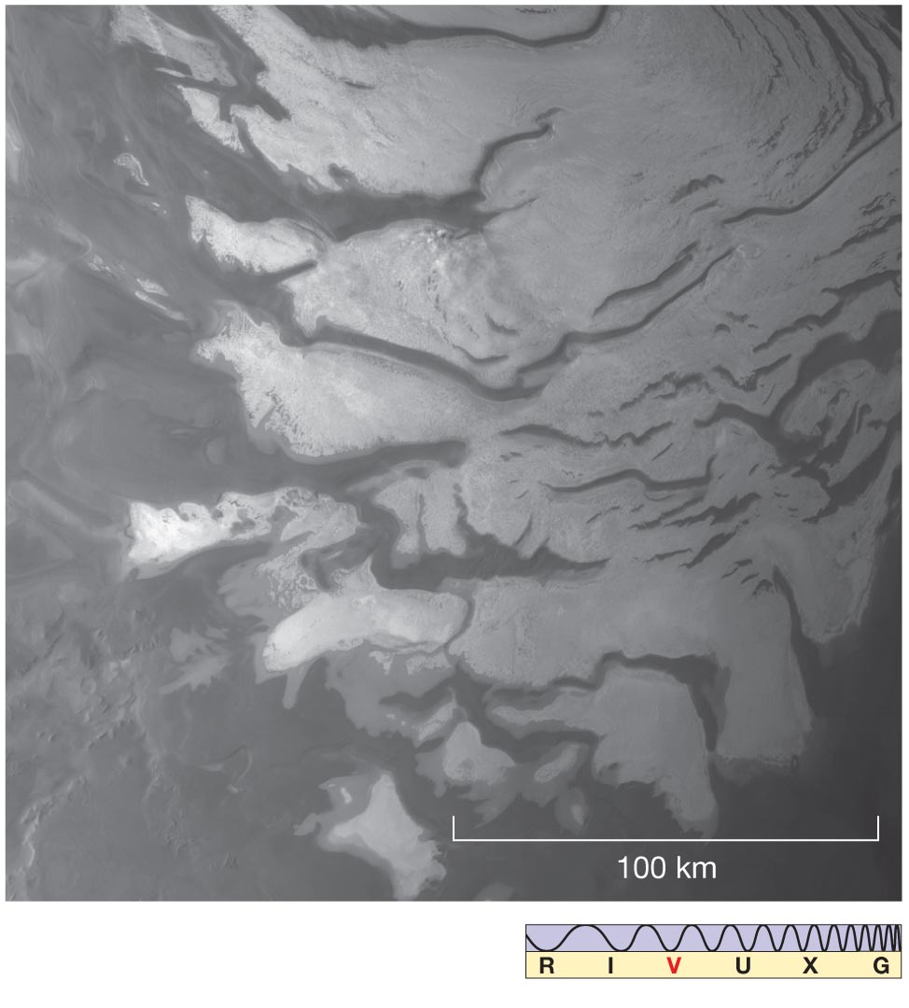
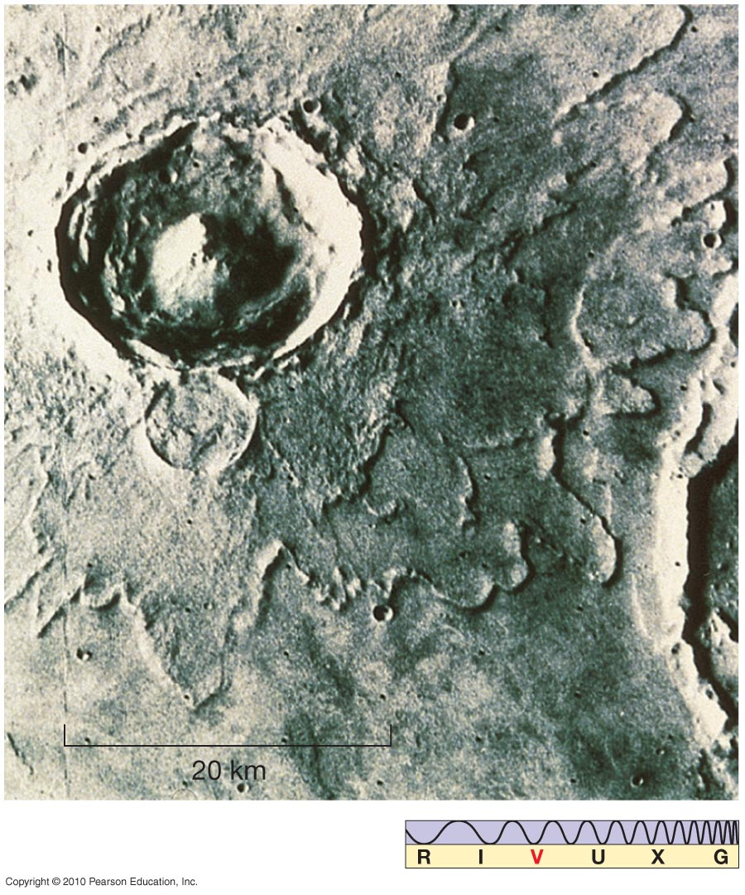
The Surface of Mars
Impact craters less than 5 km across have mostly been eroded away.
Analysis of craters allows estimation of age of surface.
Crater on right was made when surface was liquid.

Slide 28
The Surface of Mars
Recently, gullies have been seen that seem to indicate the presence of liquid water; Water melts below the surface and drains out.

Slide 29
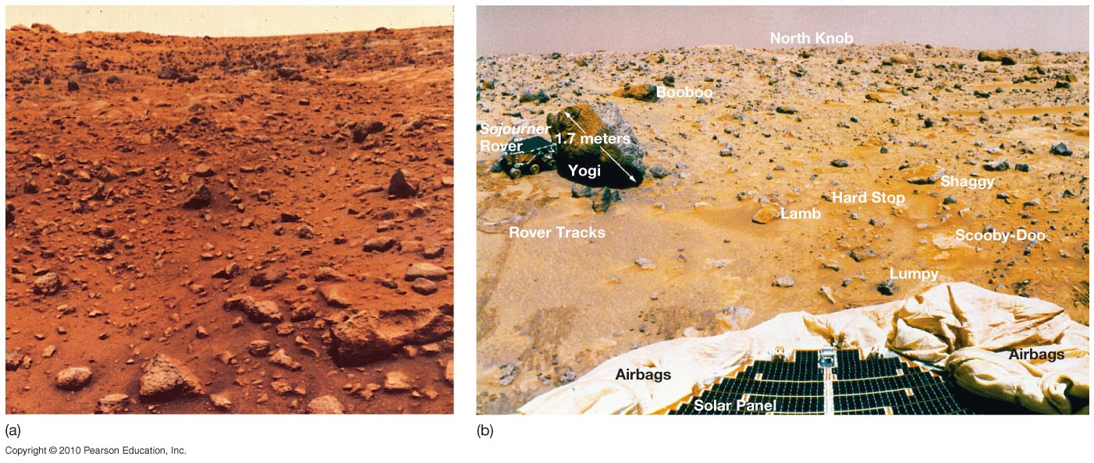
The Surface of Mars
Left: Viking photo
Right: Mars rover Sojourner, approaching “Yogi”

Slide 30
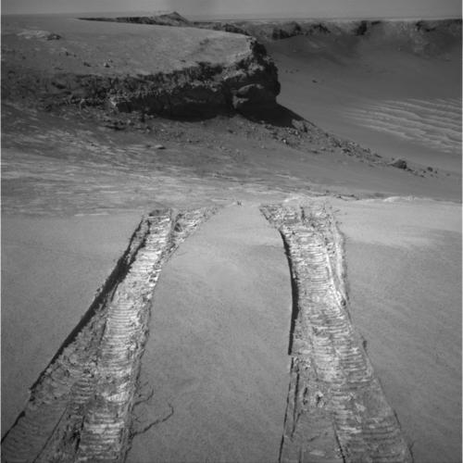
The Surface of Mars
Landscape and close-up by Opportunity rover

Slide 31
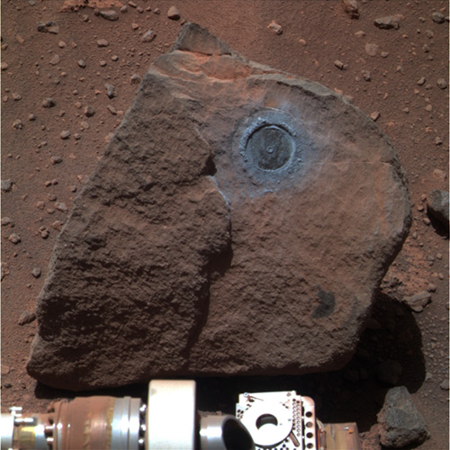
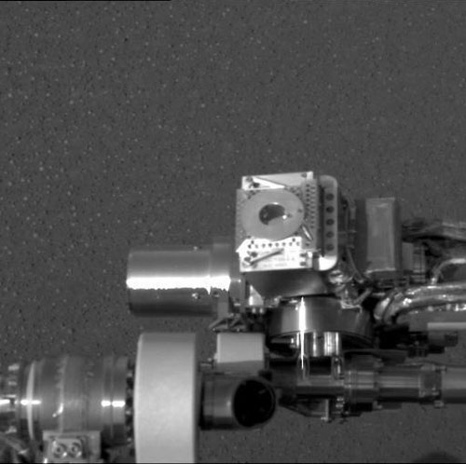
RAT & Möessbauer

Slide 32
Internal Structure and Geological History
Internal structure of Mercury, Mars, and the Moon, compared to Earth

Slide 33
Atmospheric Evolution on Earth, Venus, and Mars
At formation, planets had primary atmosphere – hydrogen, helium, methane, ammonia, water vapor – which was quickly lost.
Secondary atmosphere – water vapor, carbon dioxide, sulfur dioxide, nitrogen – comes from volcanic activity.
Earth now has a tertiary atmosphere, 21 percent oxygen, due to the presence of life.

Slide 34
Atmospheric Evolution on Earth, Venus, and Mars
Earth has a small greenhouse effect; it is in equilibrium with a comfortable (for us) surface temperature.

Slide 35
Atmospheric Evolution on Earth, Venus, and Mars
Venus’s atmosphere is much denser and thicker; a runaway greenhouse effect has resulted in its present surface temperature of 730 K.

